Slide 1
Turning skills into careers
ESCO

Slide 2
THIS IS A CRUCIAL MOMENT FOR CAREER SUPPORT
Trends like migration, automation, the transition towards a green economy as well as COVID place new demands on career support

Slide 3
THE CASE FOR A SKILL BASED APPROACH
Transitions
Experiences
Communication
Thinking in degrees and job titles disadvantages many job seekers
People face an increasing number of career transitions
Formal qualifications and titles are often not transferable
People struggle to showcase their abilities
ESCO

Slide 4
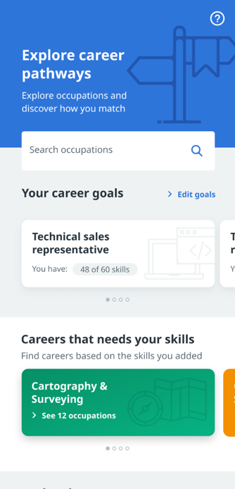
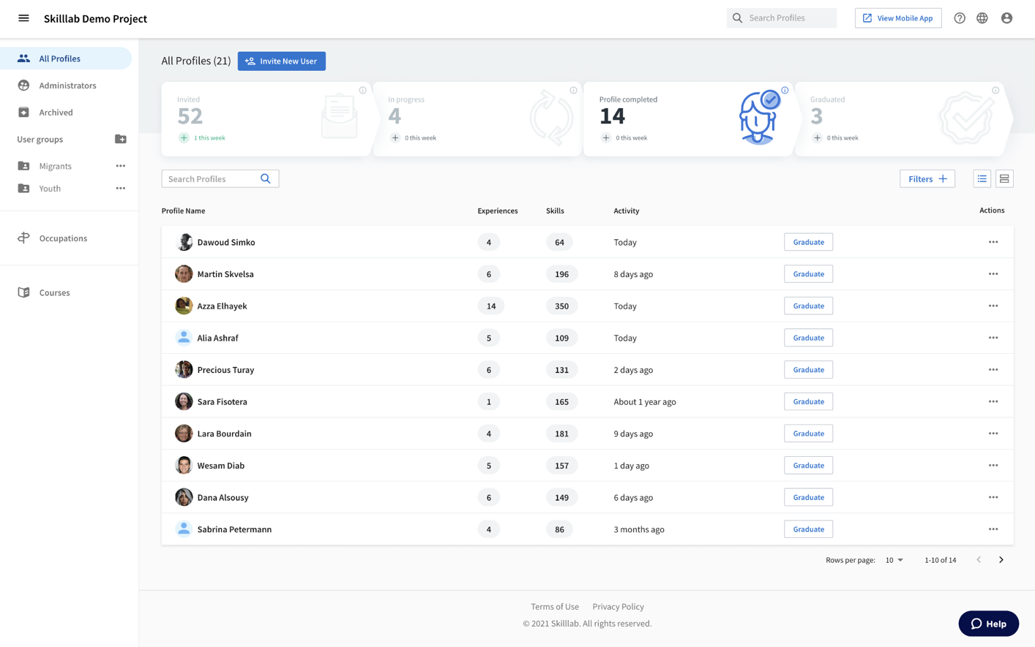
OUR APPROACH
Employment Services
Job Seekers
Skill
profiles
Career
orientation
Course
matches
Training Providers
Connecting people, jobs and education on the level of skills
ESCO

Slide 5
HOW IT WORKS
Simple steps towards 21st century career support
Invite
Start by inviting your clients
Empower
To capture skills, explore careers and apply for jobs
Support
Provide data driven and skill-based career support
ESCO

Slide 6
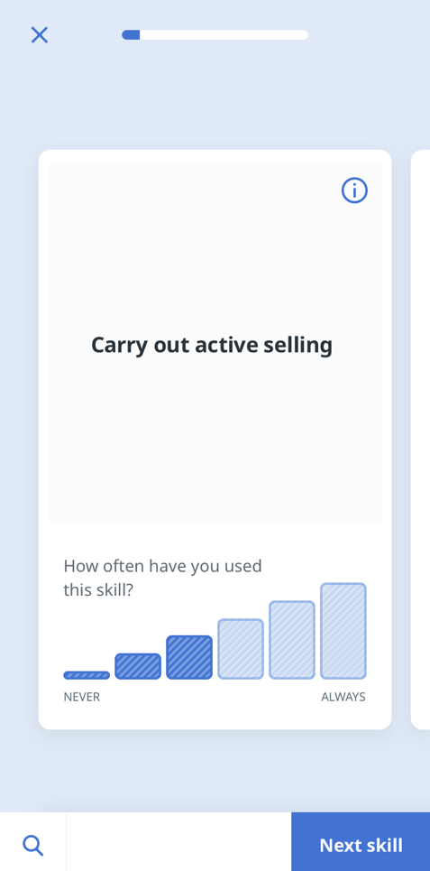
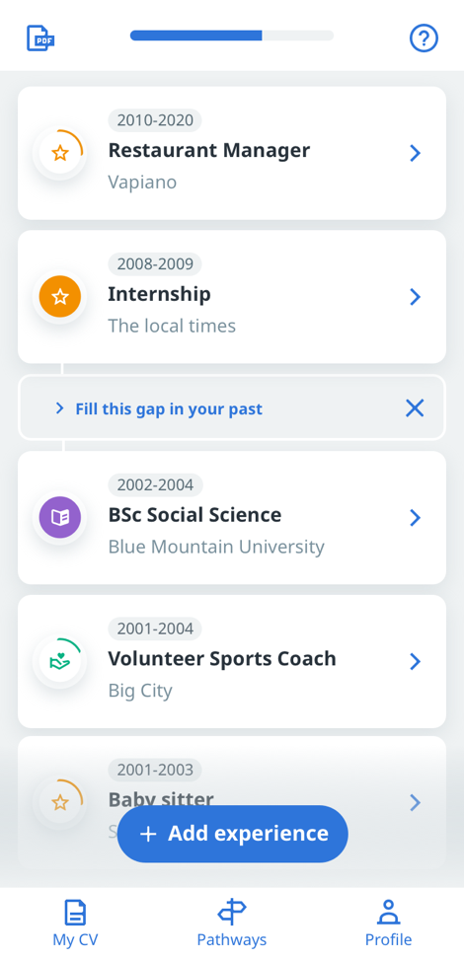
SKILL PROFILING
Our AI interviews people and captures their skills
ESCO

Slide 7
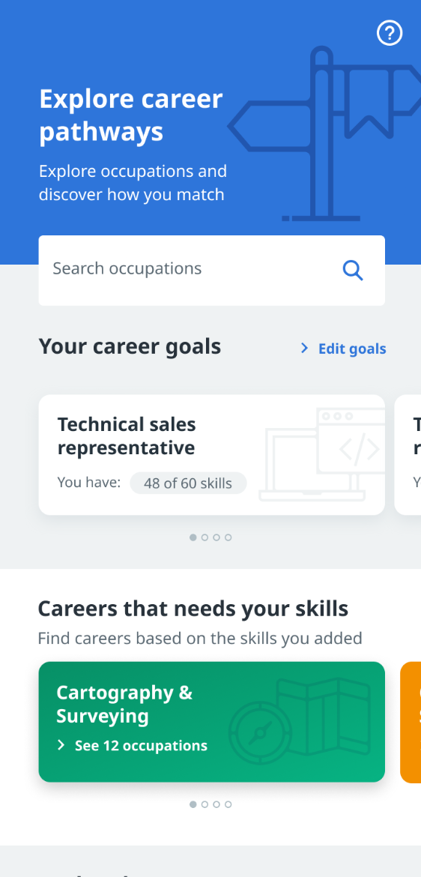
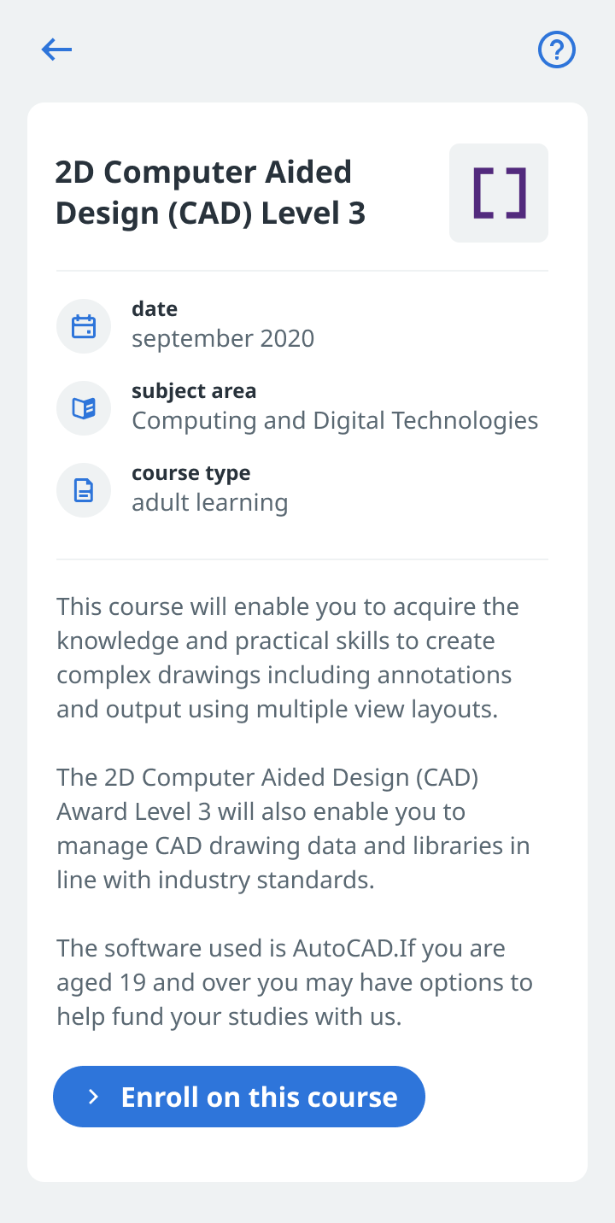
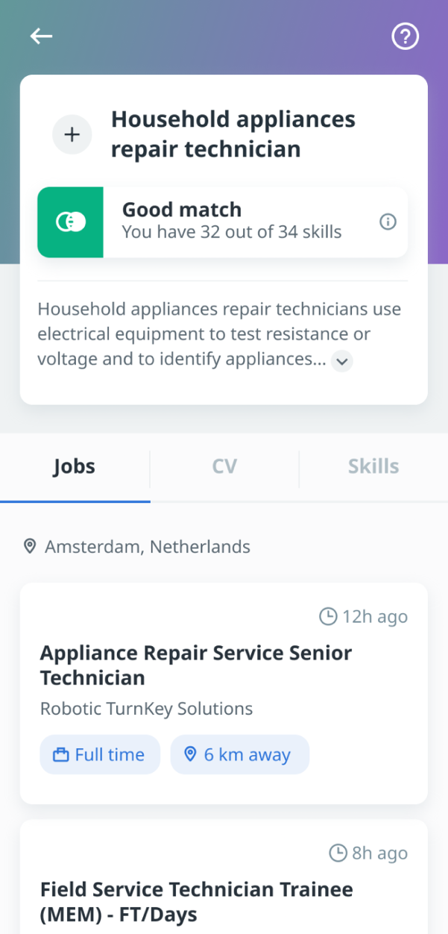
CAREER ORIENTATION
We suggest jobs and education based on a person’s skill profile
Pitch Deck 2021

Slide 8
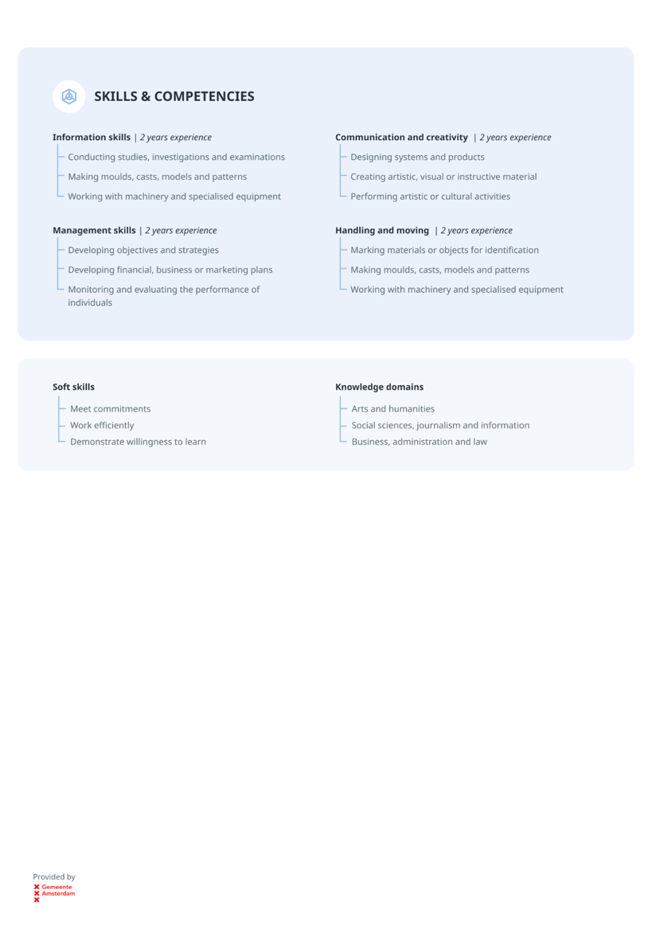
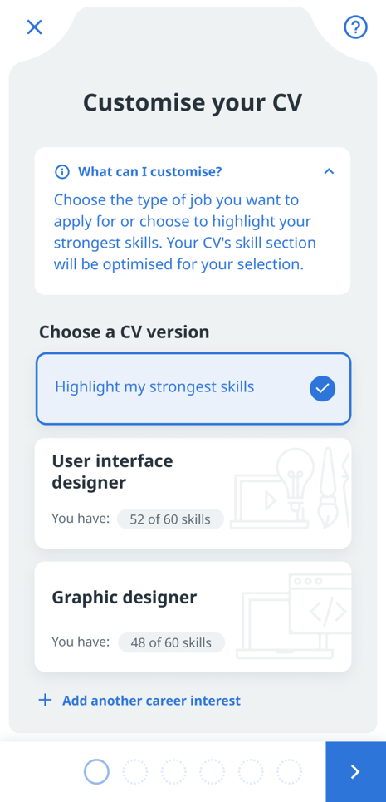
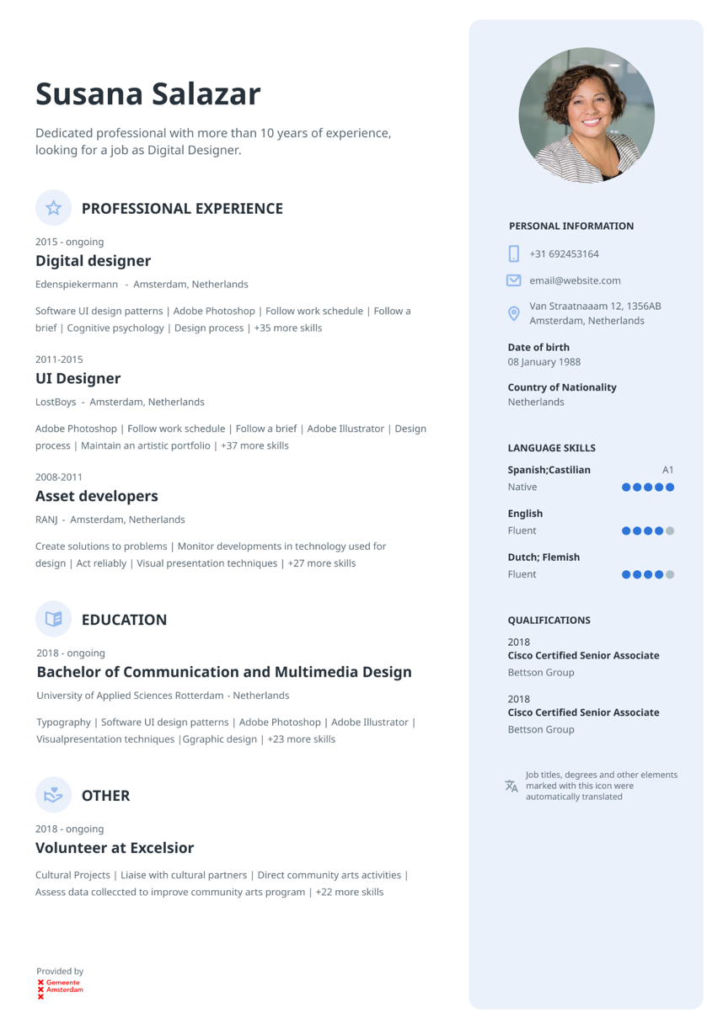
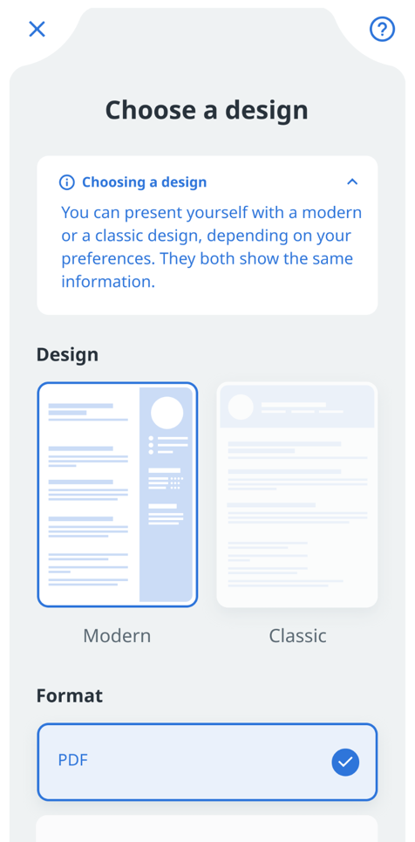
JOB APPLICATION SUPPORT
Automatically generated materials that are optimized for specific jobs
ESCO

Slide 9
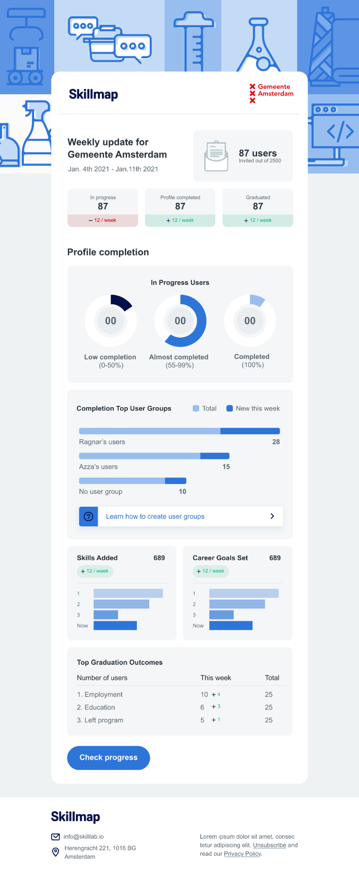
DATA DRIVEN CAREER SUPPORT
Detailed skill profiles and data-driven insights
ESCO

Slide 10
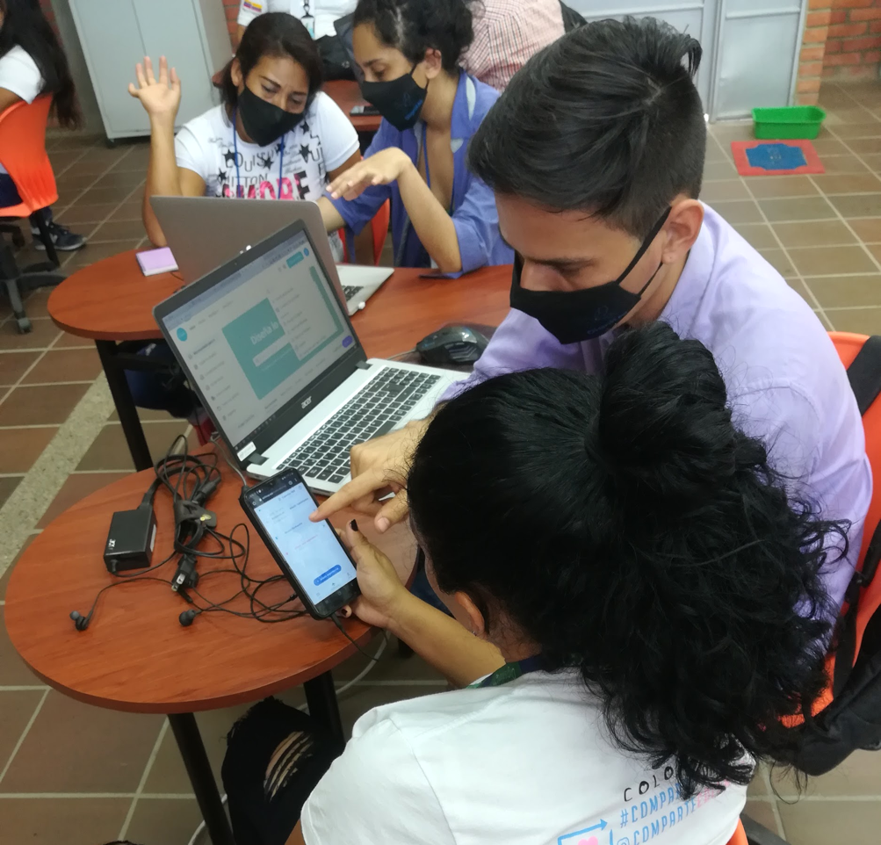
OUR PARTNERS SPEAK FOR US
“SkillLab helps me to explain the skills that my clients have and relate them to the skills employers demand.”
Partner with us to change how we value and provide service to workers
90%
SkillLab helps me to understand job seekers' experiences, skills, and employment potential
85%
SkillLab improved the ability of my beneficiaries to describe their own skills
70%
SkillLab helps me to provide better career service to job-seekers.

Slide 11
Contact:
Ulrich Scharf
u.scharf@skilllab.io
ESCO

