Slide 1
State of play of the ESCO mapping and the exchange of vacancy and cv data
Joint ESCO MSWG&MAI meeting
29 November 2021

Slide 2
EURES & ESCO 3-step implementation process
Prepare data: mapping tables
Enrich CVs and JVs with ESCO URIs
Goal: send CVs and JVs to EURES
Notes:
Let’s start by making transparent and crystal clear the entire ESCO implementation process which is a 3-step process.
The 1st step you have been doing the past 2-3 years, i.e. you have been preparing the data, you have been creating the mapping tables.
Once this is done you will be using these tables to tag your CVs and JVs with ESCO URIs in order to send them to EURES which is the purpose of the mapping exercise.
COMMISSION IMPLEMENTING DECISION (EU) 2018/1021
Article 4
Ensuring interoperability with the common IT platform through mapping tables
The mapping tables referred to in Article 3, shall be used for automatic transcoding of information on job vacancies or job seeker profiles for the purpose of automated matching through the common IT platform. Member States shall ensure that any codes of their national, regional and sectoral classifications in job vacancies and job seeker profiles under Regulation (EU) 2016/589 Article 17(1) are replaced or complemented by the corresponding codes of the European classification, by using the mapping tables for transcoding before making them available to the EURES portal.

Slide 3
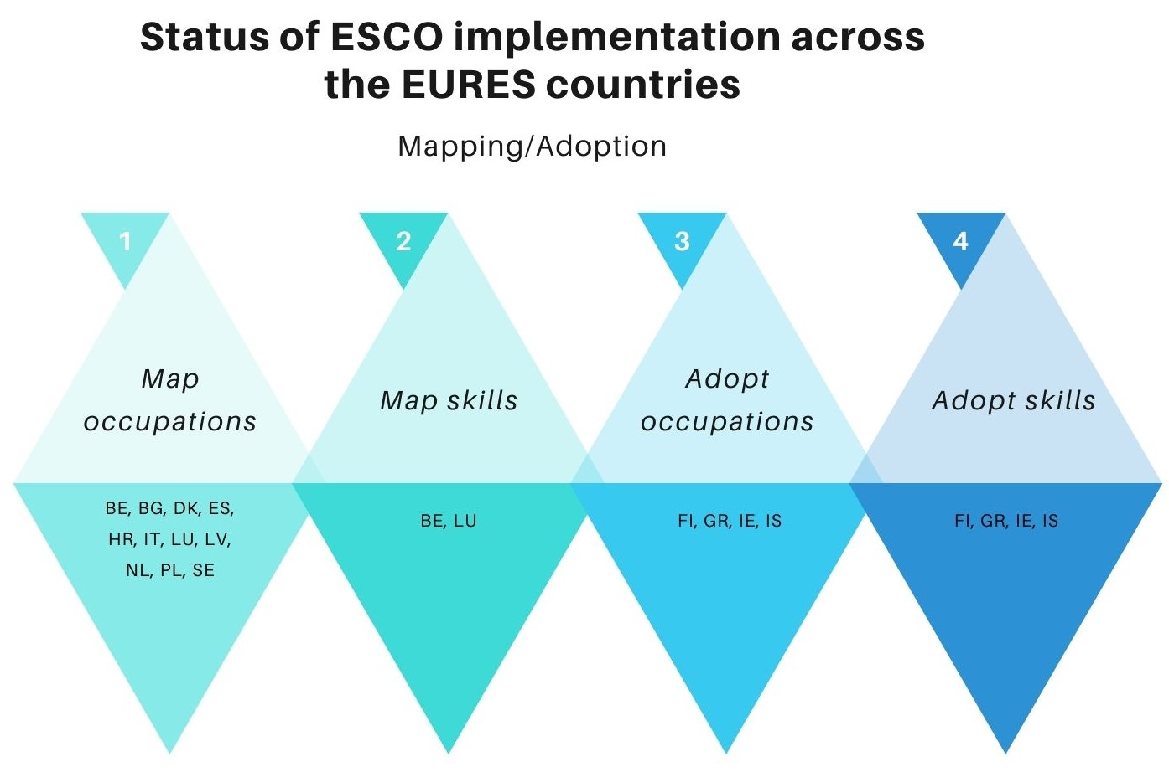
Notes:
And talking about progress, we go to the next slide. This list is not exhaustive. Information in this list stems from those MSs who have communicated to us their implementation practice either because they requested access to the mapping platform or because they submitted to us their inquiries. In order to complete this table, I would propose that we have a tour de table now during which each MS will communicate whether you adopt map or adopt ESCO, which pillars and how advanced you are.

Slide 4
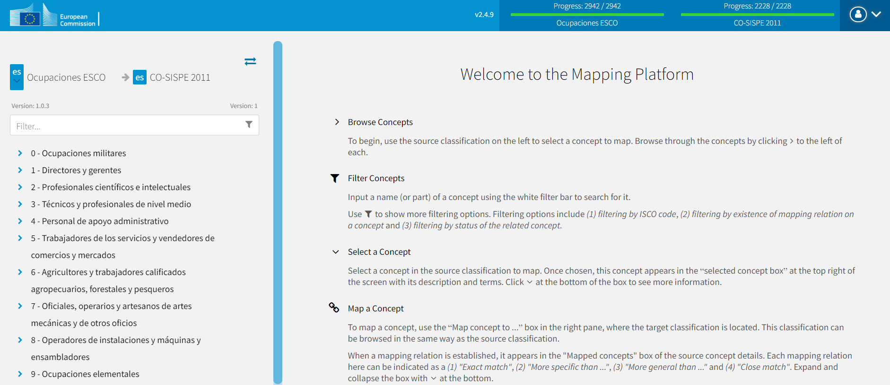
Use of mapping platform
10 EURES countries use the mapping platform

Slide 5
EURES countries pending ESCO implementation (mapping/adoption)
Work in progress mapping/adopting ESCO occupations
AT, CY, ET, FR, DE, HU, LT, MT, NO, PT, RO, SK, SI, CH
No communication
CZ, LIE

Slide 6
Why submit the mapping tables?
COMMISSION IMPLEMENTING DECISION (EU) 2018/1021

Slide 7
Why submit the mapping tables?
Continuous improvement of ESCO
1. cross-check ESCO translations
2. identify missing occupations/skills in ESCO
3. identify missing synonyms of occupations (NPTs) in ESCO
4. evaluate granularity/homogeneity of ESCO
Notes:
2. identify occupation/skill gaps ESCO, e.g. we expect to have a lot of narrowers there → create more narrow OCCs for the specialised doctor., an ESCO OCC and no exact match could mean this OCC is too specific.
3. find synonyms of occupations (NPTs) in the Member States’ language
4. granularity/homogeneity of ESCO (several narrowers to 1 ESCO OCC → means that this OCC is general and we need a specific one)

Slide 8
Exchange of vacancy and CV data within EURES
 | % ESCO in job vacancies* | % ESCO in CVs*
Nr of EURES countries | 12 | 11
% range | 25% - 65% | 2% - 42%
* Numbers were collected in October

Slide 9
Questions?

