Slide 1
Update on the implementation of ESCO in EURES
Francesco Losappio
ESCO Secretariat

Slide 2
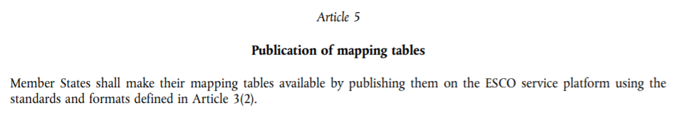
Why submit the mapping tables?
COMMISSION IMPLEMENTING DECISION (EU) 2018/1021
EURES Countries Mapping Tables | Esco (europa.eu)
Notes:
Mapping tables

Slide 3
ESCO implementation process in ESCO and EURES
Prepare data: mapping tables
Enrich CVs and JVs with ESCO URIs
Goal: send CVs and JVs to EURES
Notes:
COMMISSION IMPLEMENTING DECISION (EU) 2018/1021
Article 4
Ensuring interoperability with the common IT platform through mapping tables
The mapping tables referred to in Article 3, shall be used for automatic transcoding of information on job vacancies or job seeker profiles for the purpose of automated matching through the common IT platform. Member States shall ensure that any codes of their national, regional and sectoral classifications in job vacancies and job seeker profiles under Regulation (EU) 2016/589 Article 17(1) are replaced or complemented by the corresponding codes of the European classification, by using the mapping tables for transcoding before making them available to the EURES portal.

Slide 4
ESCO mapping/adoption across EURES countries: state of play March 2023
Mapping of occupations
AT, BE, BG, CY, CZ, DE, DK, EE, ES, FR, HR, HU, IT, LU, LV, MT, NO, NL, PL, PT, RO, SE, SI, SK
Mapping of skills
BE, DE, LU, MT, SK
Adoption of ESCO - occupation
FI, GR, IE, IS
Adoption of ESCO - skills
FI, GR, IE, IS
Notes:
Information in this list stems from those MSs who have either used the mapping platform or communicated their implementation practice to the ESCO Secretariat.

Slide 5
EURES countries pending ESCO implementation (mapping/adoption)
Work in progress mapping/adopting ESCO occupations
CH, LIE, LT
Work in progress mapping/adopting ESCO skills
BG, CY, EE, ES, FR, HR, HU, LT, LV, SE, SI
!issues related to the compliance with technical standards – Commission Implementing Decision (EU) 2018/1021
Notes:
en_Technical standards and formats necessary for the operation of the EURES Common IT Platform.pdf (europa.eu)

Slide 6
State of play of the encoding of job vacancies with ESCO URIs

Slide 7
State of play of the encoding of CVs with ESCO URIs

Slide 8
Data quality –why it matters
Quality of mappings
Improve the functioning of the EURES engine
Support the identification of missing occupations and skills and/or synonyms
Improve translations
Support training of AI models

Slide 9
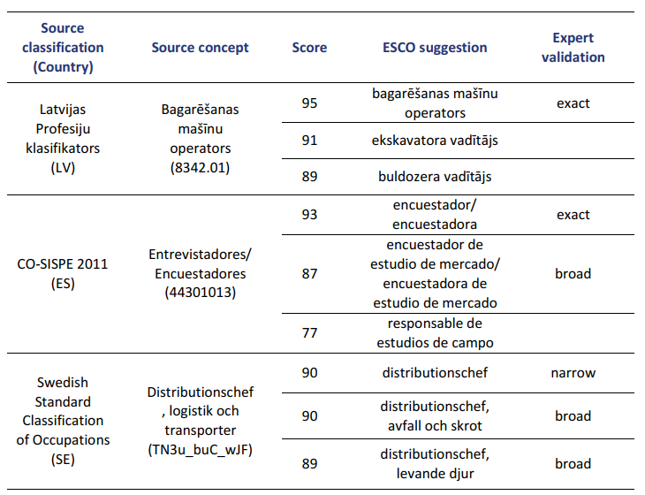
Quality control supported by artificial intelligence
Compare expert mappings with suggestions from AI model
Notes:
COMMISSION IMPLEMENTING DECISION (EU) 2018/1021
Article 4
Ensuring interoperability with the common IT platform through mapping tables
The mapping tables referred to in Article 3, shall be used for automatic transcoding of information on job vacancies or job seeker profiles for the purpose of automated matching through the common IT platform. Member States shall ensure that any codes of their national, regional and sectoral classifications in job vacancies and job seeker profiles under Regulation (EU) 2016/589 Article 17(1) are replaced or complemented by the corresponding codes of the European classification, by using the mapping tables for transcoding before making them available to the EURES portal.

Slide 10
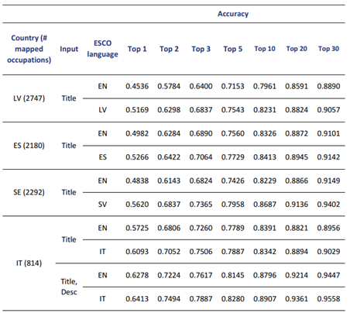
Quality control supported by artificial intelligence
Compare expert mappings with suggestions from AI model
Verify for which NOC concepts the AI suggestions match with expert mappings
Notes:
COMMISSION IMPLEMENTING DECISION (EU) 2018/1021
Article 4
Ensuring interoperability with the common IT platform through mapping tables
The mapping tables referred to in Article 3, shall be used for automatic transcoding of information on job vacancies or job seeker profiles for the purpose of automated matching through the common IT platform. Member States shall ensure that any codes of their national, regional and sectoral classifications in job vacancies and job seeker profiles under Regulation (EU) 2016/589 Article 17(1) are replaced or complemented by the corresponding codes of the European classification, by using the mapping tables for transcoding before making them available to the EURES portal.

Slide 11
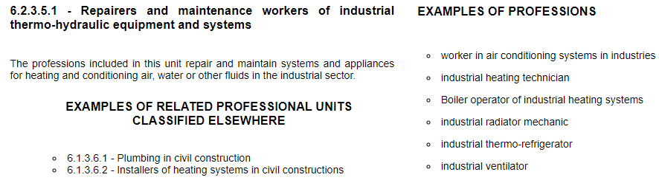
Quality control supported by artificial intelligence
Input NOC concept:
Compare expert mappings with suggestions from AI model
Verify for which NOC concepts the AI suggestions match with expert mappings
Additional check by MS for NOC concepts where AI suggestions and expert mappings do not match
Score | AI suggested ESCO concepts to be confirmed | Existing mapping
85.23 | Heating, air conditioning and refrigeration plant technicians take care of the installation and maintenance of industrial heating, air conditioning and possibly refrigeration … (NPT: HVAC heating mechanic)
85.00 | Fluid power technicians install and assemble equipment that uses liquid or gas pressure to transmit or regulate power. They also perform tests on and maintain this equipment.
77.69 | Industrial machinery mechanics work on new machinery and equipment in operation. They set up for the specific application and build accessories if necessary, perform maintenance and repair, and run diagnostics to find … | Narrow match
Notes:
COMMISSION IMPLEMENTING DECISION (EU) 2018/1021
Article 4
Ensuring interoperability with the common IT platform through mapping tables
The mapping tables referred to in Article 3, shall be used for automatic transcoding of information on job vacancies or job seeker profiles for the purpose of automated matching through the common IT platform. Member States shall ensure that any codes of their national, regional and sectoral classifications in job vacancies and job seeker profiles under Regulation (EU) 2016/589 Article 17(1) are replaced or complemented by the corresponding codes of the European classification, by using the mapping tables for transcoding before making them available to the EURES portal.

Slide 12


