Slide 1
ESCO mapping: skills
Training on ESCO Implementation
30 November 2023

Slide 2
Mapping methodology
Set up the teams and workflow​
1
Collect useful resources and documents​
2
Compare the NOC/NSC and ESCO classifications​
3
Establish mapping relations​ to ESCO version 1.0 or previous
4
Review, publish and maintain mapping relations
5
Notes:
5.3 Compare the NOC/NSC and ESCO classifications: Before creating mapping relations between the concepts of two classifications, it is important to ensure a good understanding of the types of concepts that are subject to the mapping. Each involved party should: • have the same understanding of labour market concepts (e.g. occupations, jobs, professions, skills/competences, knowledge, activities, tasks); • be aware of the differences between their data model and the ESCO data model; • know which concepts should be mapped (e.g. job groups, activities, terms). In general, the following types of classifications need to be mapped to ESCO: • Classifications that group similar jobs together and are used when registering information on job vacancies and CVs in EURES. Typically, such classifications refer to the grouping of jobs as ‘occupations’, ‘professions’, ‘job titles’, ‘job sheets’, ‘job roles’, ‘job groups’ or similar terms. These should be mapped to the occupations pillar of ESCO. • Classifications or word lists that are used to group what a candidate, employee or jobseeker knows, can do or can take responsibility for. They are used when registering information on job vacancies or CVs/candidate profiles. Typically, such classifications or word lists refer to the concepts as ‘skills’, ‘competences’, ‘knowledge’, ‘tasks’, ‘work activities’, ‘abilities’, ‘tools and technologies’, ‘product knowledge’ or ‘work context’.

Slide 3
Mapping methodology
Import classifications in order to start a new mapping project (with technical support from the Commission services);
Establish mapping tables using computer-assisted suggestions;
Revise the established mapping relations;
Update the mapping tables

Slide 4
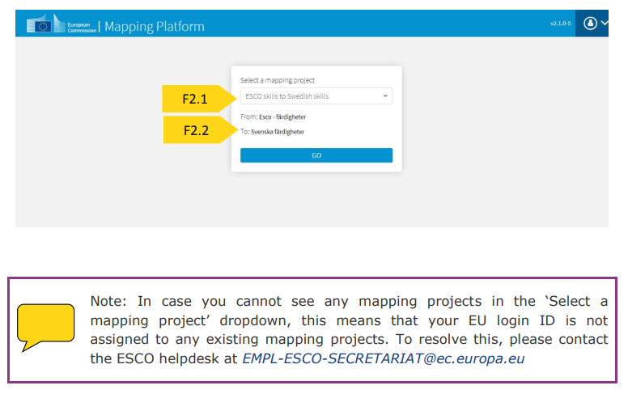
Select mapping project

Slide 5
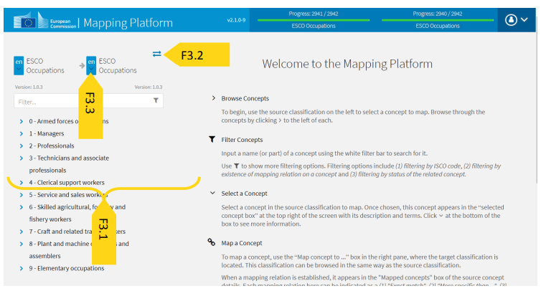
Navigate classification
F3.1: different options to navigate through the classification:
• Browse through the hierarchy
• Text search
• Filtering
F3.2:button allowing the user to switch the source and target classification
F3.3: change the language of either classification by clicking on the button next to their name

Slide 6
Browse hierarchy

Slide 7
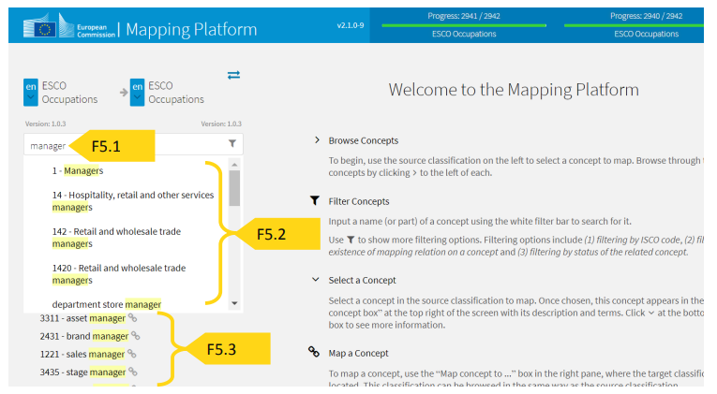
Text search
F5.2: the text you entered exactly matches part of a preferred term of an existing concept
F5.3: press the <enter> button to receive further search results

Slide 8
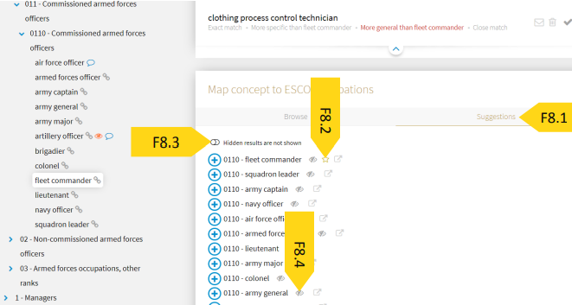
Get mapping suggestions
F8.1: Mapping suggestions
F8.2: Star icon: suggestion has a high likelihood of being the correct
F8.3: see Hidden results
F8.4: hide suggested concepts
Notes:
The mapping platform provides you with a list of concepts from the target classification that may be relevant to the selected concept of the source classification. These suggestions aim to facilitate the search for the most appropriate concept in the target classification within the mapping process. This option can be found in the ‘Map concept to …’ section [F8.1] on the right.
Some suggestions contain a star next to them [F8.2] indicating that the given suggestion has a high likelihood of being the correct mapping relation. Individual suggested concepts may be hidden. In order to see hidden concepts, click on the ‘Hidden results’ icon [F8.3]. You can also hide suggested concepts by clicking on the eye icon in case you believe the suggestion is not relevant [F8.4].

Slide 9
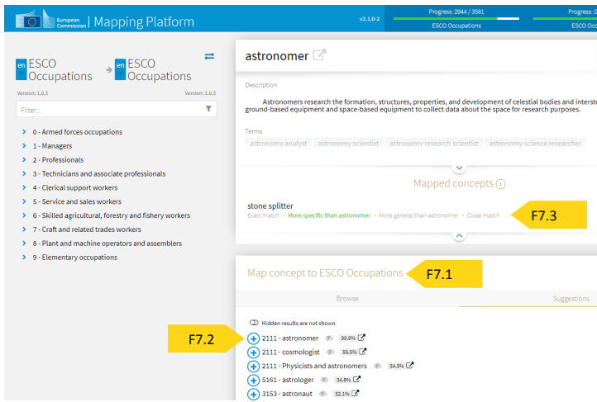
How to establish a mapping relation
F7.2: select a concept in the target classification and click on the ‘+’ icon next to its label
F7.3: when a concept is chosen, it will appear in the ‘Mapped concepts’

Slide 10
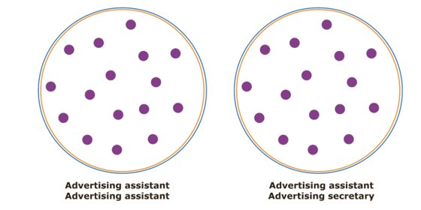
Mapping relation: exact match
Frustrationstoleranz = frustration tolerance (NSC) IS AN EXACT MATCH WITH mit Frustration umgehen = deal with frustration (ESCO)
Reinlichkeit = cleanliness (NSC) IS AN EXACT MATCH WITH auf Hygiene achten = pay attention to hygiene

Slide 11
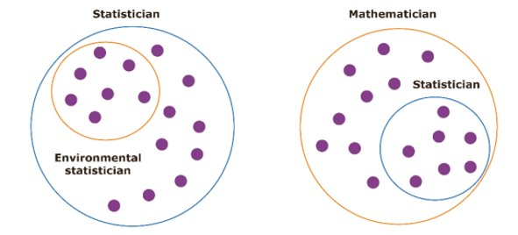
Mapping relation: more specific than
Interkulturelle Kompetenz = intercultural competence (NSC) IS MORE SPECIFIC THAN interkulturelles Bewusstsein zeigen = show intercultural awareness (ESCO);
Fachberatung = expert advice (NSC) IS MORE SPECIFIC THAN Beratung = consultation (ESCO).

Slide 12
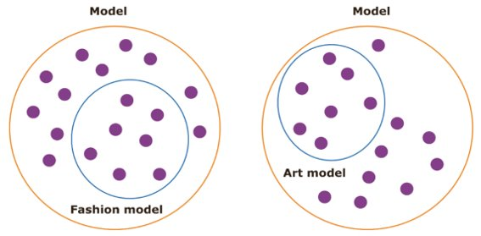
Mapping relation: more general than
Perückenherstellung = wig production (NSC) IS MORE GENERAL THAN Perücken färben = colour wigs, Perücken reparieren = repair wigs (ESCO)​
Qualitätsbewusstsein = quality awareness (NSC) IS MORE GENERAL THAN Qualität von Schuhwerk = footwear quality

Slide 13
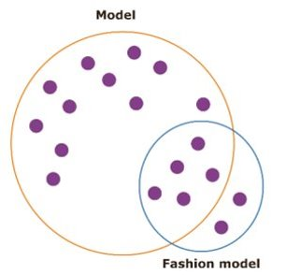
Mapping relation: close match
Kreativität = creativity (NSC) IS A CLOSE MATCH WITH kreativ denken = think creatively, kreative Ideen entwickeln = develop creative ideas (ESCO);
Urteilsfähigkeit = judgement ability (NSC) IS A CLOSE MATCH WITH Informationen bewerten = rate information (ESCO)

Slide 14
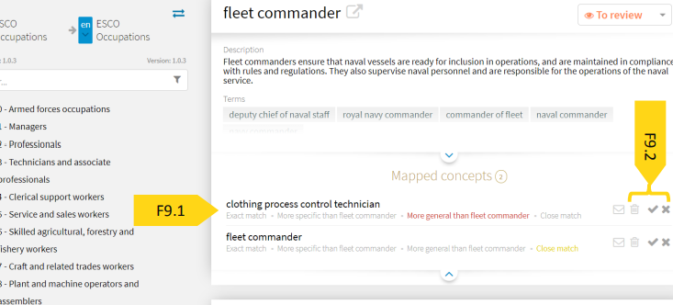
How to establish a mapping relation
F9.1: change the type of mapping relation
F9.2: validate a mapping relation by choosing from among the following options: ‘confirm, reject or delete’

Slide 15
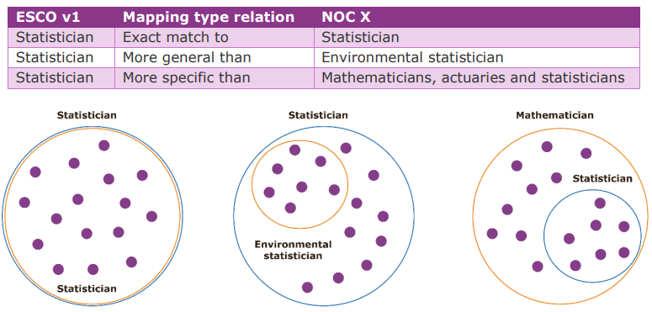
Multiple ‘exact match’, ‘more general than’ and ‘more specific than’ mapping relations

Slide 16
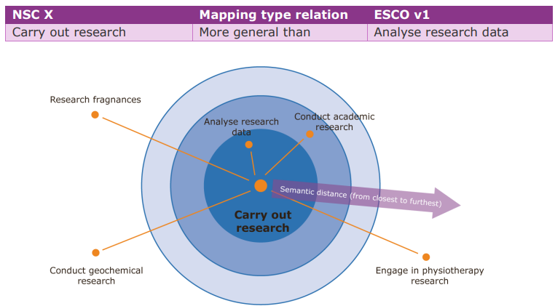
Skill concept in a NSC or ESCO is far less granular than National Classification’s skill concepts
Notes:
Explanation of the example: The skill concept carry out research is a broad concept that can be mapped as ‘more general than’ to analyse research data. While there are other concepts that could have been mapped, they should not be because their meaning is too far from the meaning of the original concept. The image above illustrates this concept of semantic distance. For example, engaging in physiotherapy research is objectively a specialisation of carry out research, but if such a relation is established then the same relation would have to be established for all the other research specialisations. This may lead to numerous (even 50+) mapping relations, which would produce undesired results and subsequently introduce further ‘noise’. This would decrease the effectiveness of document exchanges (CVs and job vacancies) in the context of EURES. The high number of relations would also increase the effort and cost of maintaining the mapping tables.

Slide 17
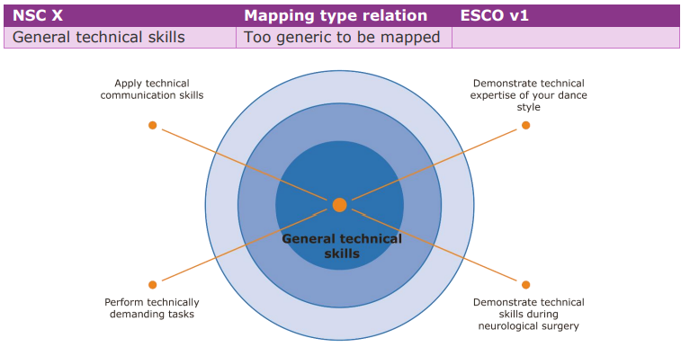
Skill concept in a NSC or ESCO is far less granular than National Classification’s skill concepts
Notes:
Explanation of the example: The general technical skills concept is too abstract to be mapped to any skill concept in the other classification. The word ‘general’ widens the broadness of technical skills even more. As displayed in the diagram above, general technical skills in ESCO are distributed across a wide range of sectoral economic activities and transversal skills that are too ‘far’ from the nature of general technical skills.

Slide 18
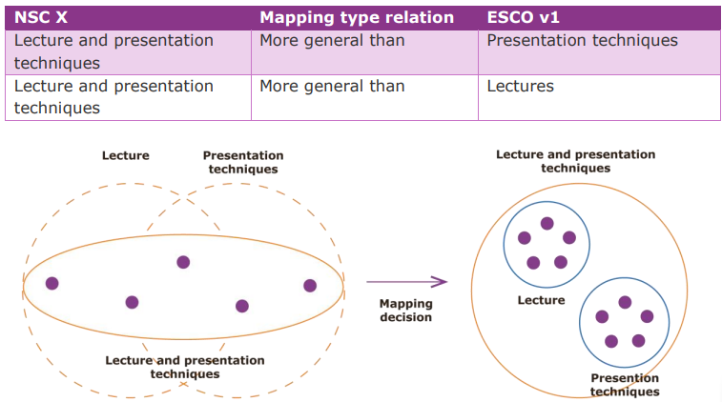
NSC X compound skill mapped to ESCO
Notes:
Explanation of the example: If the lecture and presentation techniques skills do not exist in the NSC X as separate knowledge concepts, lecture and presentation techniques can be considered to cover both areas of lecture and presentation and is therefore ‘more general than’ the concept lecture and the concept presentation techniques.

Slide 19
Recommendation: take into account all metadata
Preferred term
Description
Non-preferred terms
Broader terms
Any available evidence of labour market trends

Slide 20
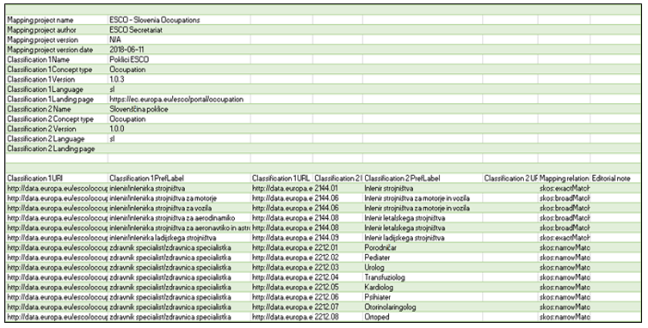
Technical standards and formats necessary for the operation of the EURES common IT platform
Metadata header
Mapping relations

Slide 21
Questions?
Clarissa Vieira: EMPL-ESCO-SECRETARIAT@ec.europa.eu

