Slide 1
Use of ESCO when transmitting JVs/CVs
ESCO Workshop
Enhancing Job Mobility through a Common Language
01/12/2023
Notes:
Divider Slide

Slide 2
EURES
Largest pan-European network supporting cross-border mobility in real-time
  1 million CVs
  3.9 million JVs
  5 thousand employers
Large network of EURES advisors in 31 country
Legal provisions (EURES Regulation 2016/589)
Notes:
Content Main Slide

Slide 3
EURES Functionality
Collect CVs
Provide Searching and
Matching Services
for citizens and
EURES Network
Collect JVs
Provide
Information Services
for citizens and
EURES Network
Collect LMI/LWC
Information
Maintain PMS, PC/APR
Provide
follow-up reporting
Coordinate EURES
Network
Notes:
Content Main Slide

Slide 4
EURES and Big Data
EURES Real-Time Data
Job-seeker (1M)
Job-vacancy (4M)
Offer-side:
Education
Experience
Skills & Qualifications
Demand-side:
Location
Occupation
Working conditions
Offer-side:
Location
Occupation
Salary
Working conditions
Demand-side:
Education
Experience
Skills and Knowledge
Notes:
Content Main Slide

Slide 5


EURES matching dimensions
Candidate has:
Position requires:
Education
Education
Work experience & skills
Work experience & skills rule
Work experience & skills
Languages
Languages rule
Languages
Candidate desires:
Position provides:
Desired location
Location rule (!)
Job location
Desired occupation
Occupation rule (!)
Job industry
Industry rule
Job function
Desired contract type
Contact type rule
Contact type
Salary
CV
JV
EURES matching solution (schematic)

Slide 6
ESCO Occupations
Matching Dimension 2 (Occupations)
  ISCO vs ESCO when and how to encode?
  Multiple ESCO Occupations

Slide 7
MD2: Occupation (ESCO)
JV*
CV*
Position Opening
Candidate/
Cand. Profile
Job Category
Required
Experience
Desired Occupation
Position
History
ESCO
Occupation
ESCO
Occupation
ESCO
Occupation
ESCO
Occupation
ESCO
Occupation
ESCO
Occupation
ESCO
Occupation
ESCO
Occupation
+duration
+duration
JV-MD-2.1
JV-MD-2.2/3
CV-MD-2.1
CV-MD-2.2/3
100%
17%/22%
89%
47%
*) simplified hierarchy path is shown

Slide 8
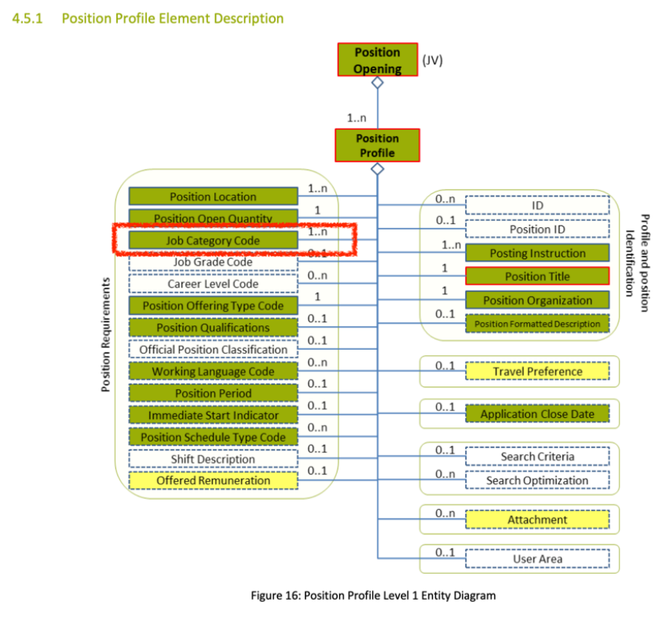
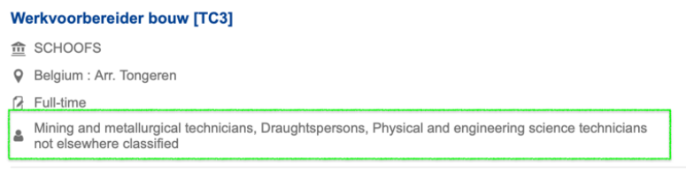
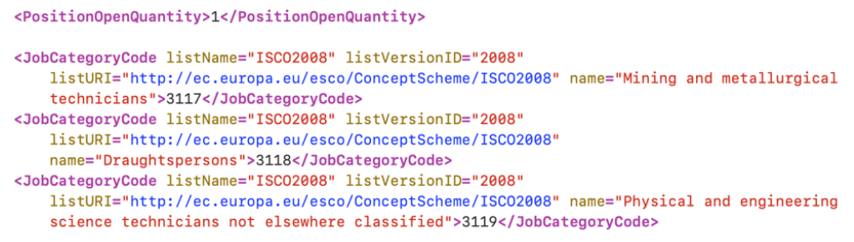
ESCO Occupations
Example as ISCO
*) simplified hierarchy path is shown
Notes:
Content Main Slide

Slide 9
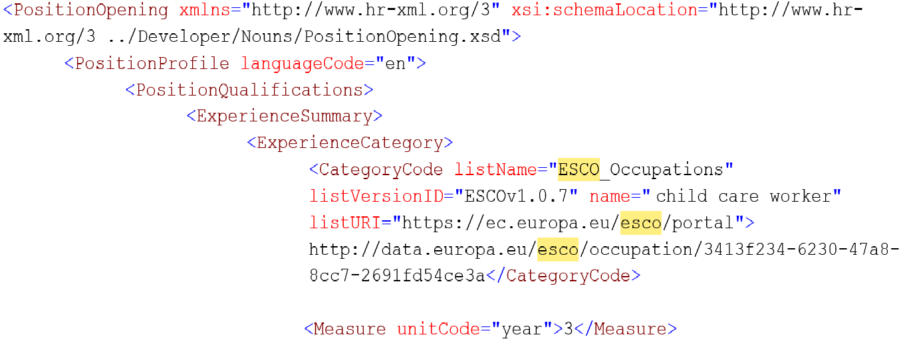
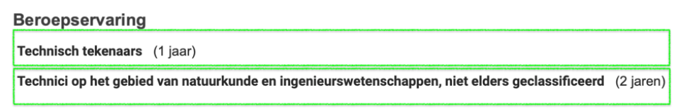
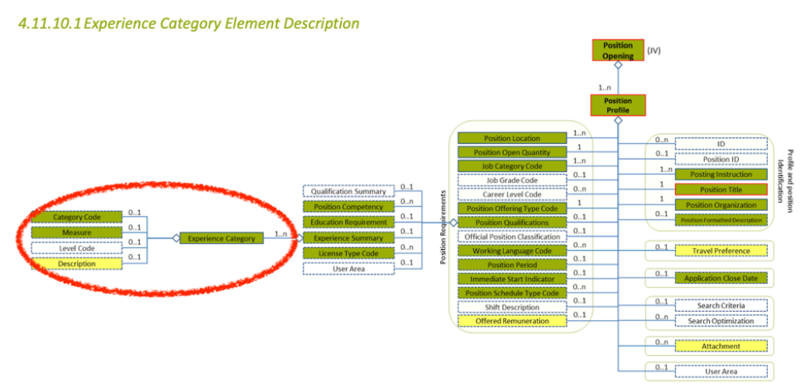
ESCO Occupations
Examples ESCO
Notes:
Content Main Slide

Slide 10
Multiple mappings
Country | Totals Concepts | Concepts with 1+ ESCO mappings | Percentage of ESCO 1+ mappings
Spain | 2225 | 47 | 2%
Croatia | 3370 | 1416 | 42%
Germany | 4077 | 1267 | 31%
Poland | 2818 | 787 | 28%
Netherlands | 3222 | 1125 | 35%
Sweden | 3296 | 888 | 27%
*) status 2022

Slide 11
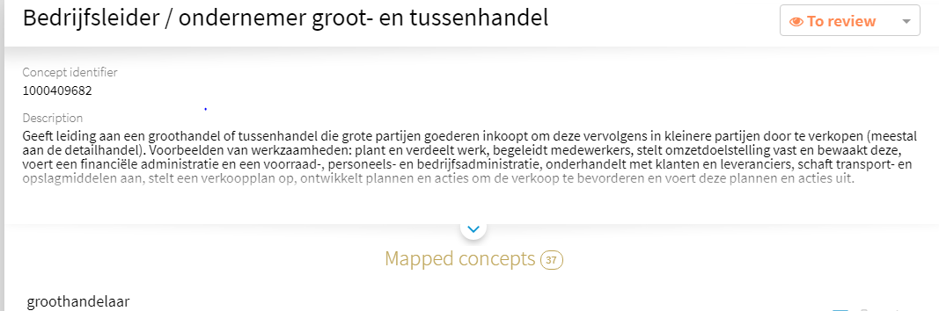
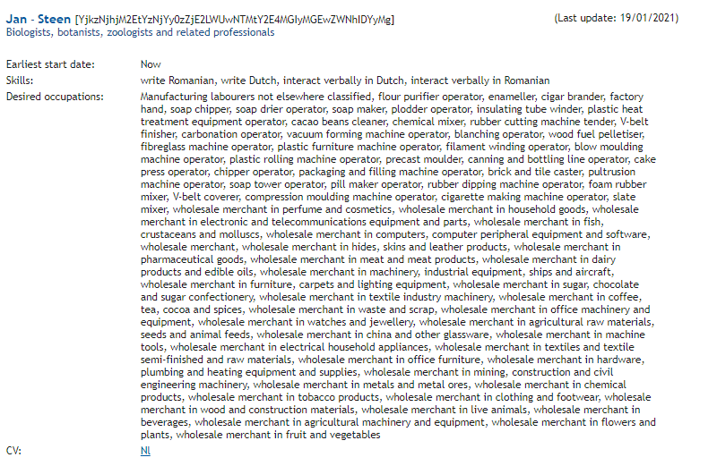
Mapping vs Sending
37 CONCEPTS MAPPED
37 CONCEPTS SENT

Slide 12
Mapping multiple concepts (broader)

Slide 13
Mapping multiple concepts (broader)

Slide 14
Mapping multiple concepts
(narrower) ex.1

Slide 15
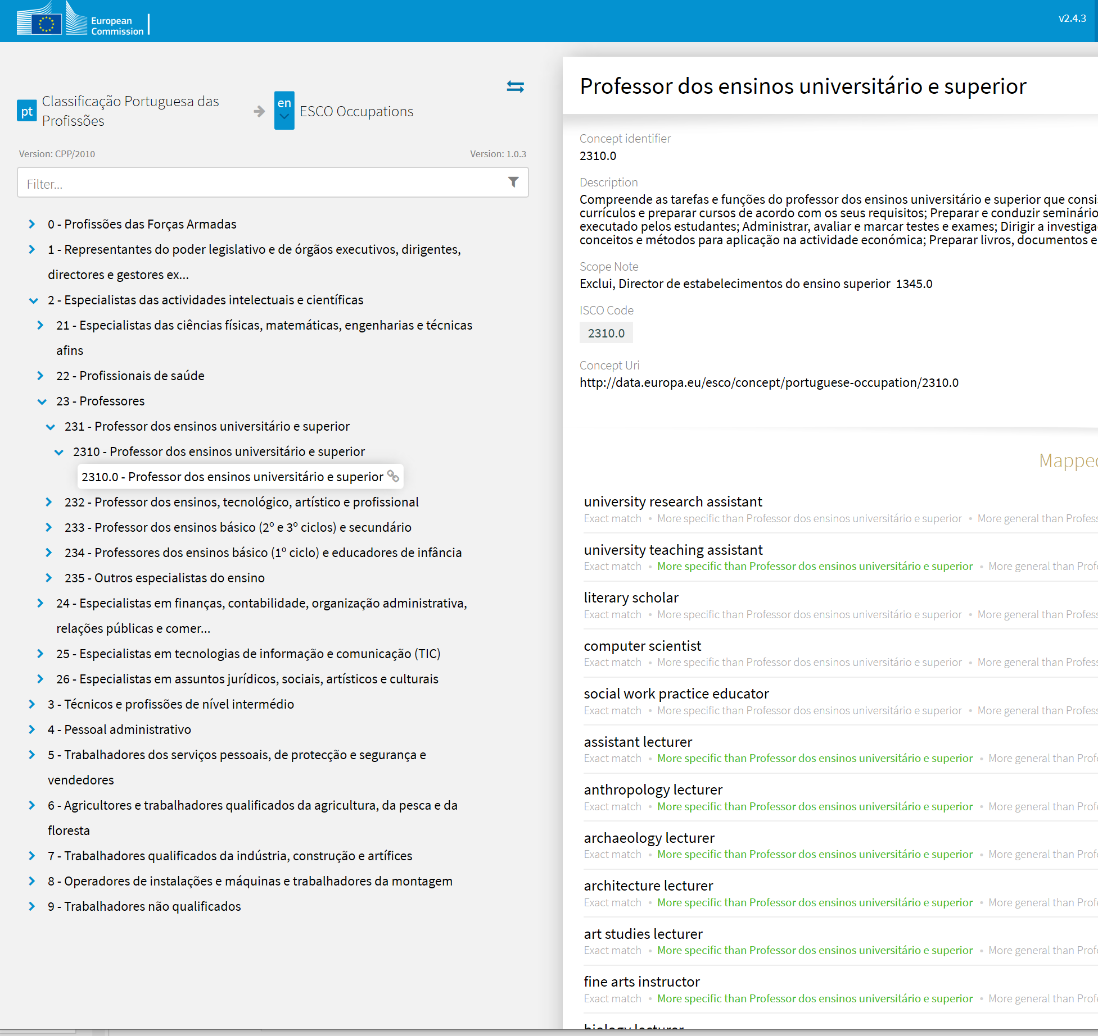
Mapping multiple concepts
(narrower) ex.2

Slide 16
Mapping multiple concepts
(narrower) ex.2

Slide 17
Logic for sending NOC data to EURES
IF multiple mapping relations (limit of 3)
a. IF 1 or more exact matches
→ send exact ESCO URIs
b. IF 1 NOC concept is “more specific than” ESCO concepts
→ send broader ESCO URIs
ELSE IF 1 mapping relation (whichever) exists
→ send that ESCO URI
send ISCO unit group URIs (fall-back)
Notes:
Goal: utilize mappings that MSs have established to a large extent/as much as possible.

Slide 18
ESCO Skills
Matching Dimension 3 (Skills)
  Competency JV
  Competency CV
  Language skills vs other skills
  CEFR vs ESCO

Slide 19
MD3: Skills (ESCO)
JV*
CV*
Position Opening
Candidate Profile
Position
Competency
Qualifications
Employment Period
ESCO
Occupation
ESCO
Skill
JV-MD-3.1
Person Competency
- Dimension
Person Competency
- Dimension
ESCO
Occupation
ESCO
Occupation
ESCO
Skill
ESCO
Skill
+ period
CV-MD-3.1
CV-MD-3.2/3
*) simplified hierarchy path is shown

Slide 20
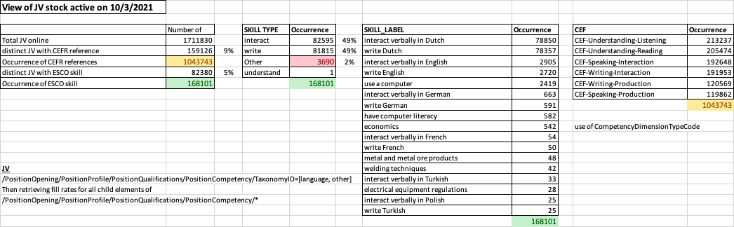
Competency JV
Competency
ESCO Skill
Language Skill
Non-qualified
Qualified
Other Skill
Lang.
Skill
ISO Code + Score (CEFR)
<1%
4%
9%

Slide 21
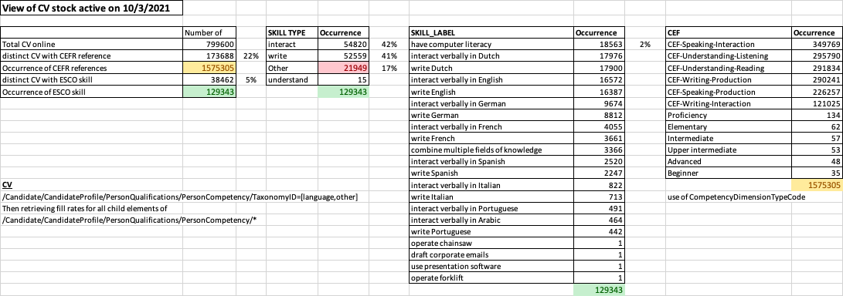
Competency CV
Competency
ESCO Skill
Language Skill
Non-qualified
Qualified
Other Skill
Lang.
Skill
ISO Code + Score (CEFR)
1%
4%
21%

Slide 22
Conclusion:
Consult EFSS v 1.4 for serialization of JV and JSP:
  Mandatory elements
  Examples URI encoding
Use ‘Use of Multiple ESCO Occupations v10’ for:
  guidance on when /how to reduce number
  of data elements when applicable
Use EURES JIRA (INTEROP) in case of questions
and seeking support

Slide 23
ec. europa.eu/eures
Thank you!
Notes:
Content Main Slide

