Slide 1
Mapping of Green and Digital ESCO Skills
Petter Nygård
Arbetsförmedlingen

Slide 2
Why?
Kickstart React-EU project – ESF funding for unemployed losing their jobs due to the pandemic
One third of the funding should contribute to a carbon efficient economy
Idea came about to use the ESCO green and digital skills set to statistically monitor contribution
Ambition to develop a method for adding a green/digital dimension to labour market data, including PES services such as matching jobseekers, labour market demand forecasting, etc.

Slide 3
ESCO mapping - technical solution
ESCO occupations and ESCO skills as concepts in taxonomy database
type: esco-skill
type: esco-occupation
All ESCO concepts have their own IDs
Taxonomy Editor – in-house developed administration software
On the fly updates of all taxonomy concepts
For example, user suggestions are quickly implemented
Ad hoc version managment, not bound by PES services
Efficient for managing ESCO mappings – contact for a demo
Open source code in GitLab

Slide 4
ESCO vs. SE skills classification
ESCO skills | SE Skills classification
App. 13 000 skill concepts | App. 6000 skill concepts
Skills include descriptions | Skills lack descriptions
More complex hierarchy | Less complex hierarcy
Fine level of granularity | Comparatively broad semantic scope
Skills linked to occupations | Skills linked to ISCO groups, not occupations
Relevance for linked occupations (essential, optional) | No relevance specified

Slide 5
ESCO mapping example - skills
Broad math
natural gas liquids fractionation processes
design natural gas processing systems
natural gas liquids recovery processes
ensure compliance with gas distribution schedule
gas dehydration processes
SE skill – Natural gas technology

Slide 6
Green/digital dimensions on the Swedish labour market
Lack of harmonised approach in Sweden
Various government assignments and private initiatives
Action point 6 – European Skills Agenda – green and digital transition
Defining a taxonomy of skills for the green transition, which will allow the statistical monitoring of the greening of our professions.
Assignment given to ESCO to provide a framework
Idea to use the ESCO green and digital skills set as a reference for the Swedish labour market

Slide 7
ESCO green and digital skills set
Green skills, Cedefop definition:
”the knowledge, abilities, values and attitudes needed to live in, develop and support a society which reduces the impact of human activity on the environment.”
Digital skills, DigComp 2.2 framework:
“Digital competence involves the confident, critical and responsible use of, and engagement with, digital technologies for learning, at work, and for participation in society. It includes information and data literacy, communication and collaboration, media literacy, digital content creation (including pro-gramming), safety (including digital well-being and competences related to cybersecurity), intellectual property related questions, problem solving and critical thinking.” (Council Recommendation on Key Competences for Life-long Learning, 22 May 2018, ST 9009 2018 INIT).
Recomended reading:
Jobs for the Green Transition: Definitions, classifications and emerging trends. https://cdn.ceps.eu/wp-content/uploads/2023/09/CEPS-In-depth-analysis-2023-12_Jobs-for-the-green-transition-1.pdf

Slide 8
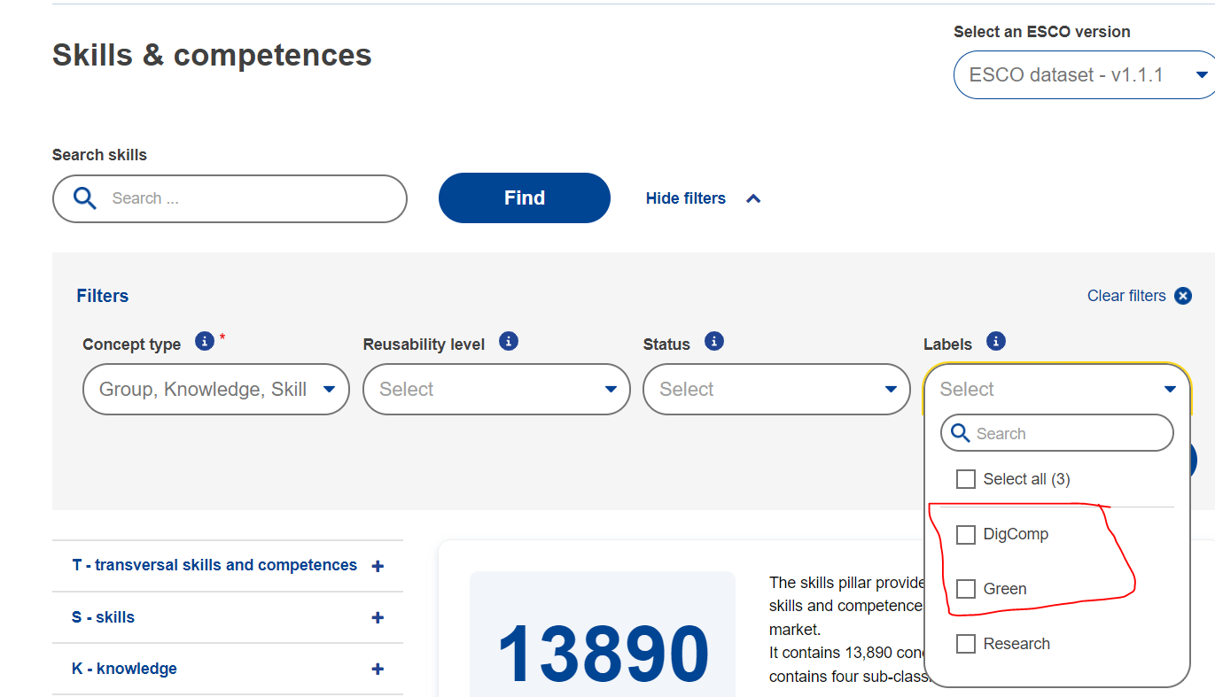
ESCO green and digital skills set cont.

Slide 9
Mapping of ESCO green and digital skills
ESCO G/D skills set
Mapping relations
SE skills set
ESCO skills <> SE skills mapping completed
19.3 (EU) 2018/1021
Using definitions (Cedefop, DigComp) to review mapped SE skills
Can mapped SE skills be considered green/digital? Yes and no.
Green ESCO skills ’over mapped’ to SE skills - Identifying need for new SE skills
SE skills lacking, but should have, green or digital mapping

Slide 10
Green skills mapping - example
ESCO skill
types of wood
Furnishing repairs
Studio carpentry
Decorative carpentry
Carpentry, film/Carpentry, TV
Broad match
ESCO green skill too general – green aspect does not translate to mapped narrow SE skills
Identified a need for a new SE skill, but able to keep green dimension

Slide 11
Green skills mapping – example cont.
ESCO skill
types of wood
Knowledge of materials in craftsmanship
narrow match
Relevant ISCO groups
ESCO skill
Match type
New SE skill
New SE skill ’Knowledge of materials in craftsmanship’
Not present in JOVs, but offered through educational programs as a learning outcome
New skill is semantically broad - able to map to several ESCO skills
Relevant for several ISCO groups related to craftsmanship

Slide 12
What about the rest of the skills?
Should SE skill be green or digital?
SE skills without
G/D mapping
DigComp2.2
Green skills definition
New mapping
New SE skill
SE skills that were not mapped to greend/digital ESCO skills
Reviewing SE skills – hybrid process
SE skills lack description – pretty straightforward process
Should SE skill be green/digital according to definitions applied by ESCO
Using the same definitions as ESCO in the SE analysis

Slide 13
Digital skills mapping – example
travel booking processes
Amadeus, travel booking system
Broad match
ESCO skill
Match type
SE skill
SE skill lacks mapping to digital ESCO skill
SE skill can be attributed to DigComp framework
”use of … digital technologies … at work”
No identified need for new SE skill – existing SE skill relevant in JOVs
Identified a need for mappings to digital ESCO skill

Slide 14
Digital skills mapping – example cont.
travel booking processes
Amadeus, travel booking system
Broad match
use IT tools
ESCO skill
Match type
SE skill
Added mapping to digital ESCO skill ’use IT tools’
Alternatively – new general SE skill ’travel booking software”
Not relevant in this case as clear skill demand in JOVs for specific software

Slide 15
Green and digital skills mapping - conclusions
433 SE skills mapped to green ESCO skill
1438 SE skills mapped to digital ESCO skill
Mapping has involved a major review of SE skills classification AND mappings to ESCO skills – making SE skills classification more current
Added several new SE skills – if there is a clear demand on the labour market and/or offer from educational system
Advantages of using ESCO as a reference
Reliable and updated source promoting interoperability, encouraging user input
Mappings to up-to-date ESCO concepts > up-to-date national classification
Disadvantages of using ESCO as a reference
Less control of national classification – however in control of mappings
Long-ish time between ESCO updates

Slide 16
Green and digital skills mapping - applications
Green and digital mappings available today (API, public website)
No PES applications so far, sparked interest in several departments
Initiated testing the model with labour mobility resarchers
Initiated work on testing the mappings on university course descriptions
Take home message – mapped green/digital SE skills may contribute to the green transition, depending on circumstances
By design a vague guidance in terms of how to use the data

Slide 17
G/D skills in labour market analysis - LMTs
Prevalence of green/digital SE skills in labour market training programs
LMTs comprised of set of modules with intended learning outcomes
Learning outcomes mapped to skill concepts
Mapped skills identified as mapped to green/digital ESCO skill
LMT X
Module A
Module B
Module C
Module A
Description of intended learning outcomes.
Module A – mapped skills
Skill A – mapped green ESCO skill
Skill B – mapped digital ESCO skill
Skill C – not mapped

Slide 18
G/D skills in LMTs - Example
Example LMT: Construction woodworker – Module: Wooden frames 1
Wooden frames 1
Simpler planning and calculations to solve the tasks. Wooden frames, for example joists, regulations, roof structures and prefabricated wooden structures. Mold construction. Insulation material against sound, heat and cold. Wind protection and diffusion. Protection of building structures against moisture damage. Wood materials and different types of insulation materials and their properties. The processing process of the wood material. Tools and machines for various purposes, handling and maintenance […].
Wooden frames 1 – mapped skills
General work environment training
Shaping
Sorting of construction waste
Sustainable material choices, construction
Insulation
Mechanical knowledge, construction
Materials planning, construction
Vocational mathematics, construction
Several more not displayed

Slide 19
Green jobs – inter-government agency project
Project tasked with establishing list of green jobs
Swedish Public Employment Service, Swedish National Agency for Higher Vocational Education and Statistics Sweden
Inter-government agency working group tasked with defining green jobs
Swedish Public Employment Service, Swedish National Agency for Higher Vocational Education and Statistics Sweden
ESCO occupations ranked based on number of essential/optional green skills
SE occupations mapped to ’green’ ESCO occupations – SE occupations with ’exact match’ yields promising results
Demo – Excel sheet

Slide 20
Contact
petter.nygard@arbetsformedlingen.se – Occupational analyst, Arbetsförmedlingen
Sources
https://gitlab.com/arbetsformedlingen/taxonomy-content/taxonomy-content-documentation/content/-/blob/main/doc_sv/kompetenssamlingar.md
https://jobtechdev.se/sv/komponenter/jobtech-taxonomy
https://atlas.jobtechdev.se/page/taxonomy.html
https://taxonomy.api.jobtechdev.se/v1/taxonomy/swagger-ui/index.html
https://gitlab.com/arbetsformedlingen/taxonomy-dev/frontend/jobtech-taxonomy-editor

Slide 21
Thank you Questions?

