Slide 1
The European Skills, Competences, Qualifications and Occupations (ESCO) Alternative hierarchies and clustering Member States Working Group: 1st focus group
14 September 2022

Slide 2
Introduction
ESCO scopes out what alternative hierarchical approaches could complement the current ESCO hierarchy
Notes:
Many thanks.
As mentioned by Lambert, in this meeting we are focusing on the ESCO hierarchies and potential ways

Slide 3
State of play: the ESCO hierarchy
Mono-hierarchy based on the top-down principle
Consists of two pillars: the occupations and the skills & competences pillar
The skills/competences pillar
4 sub-pillars: skills, knowledge, languages and transversal
Multi-level hierarchies
13890 occupations
The occupations pillar
first four levels build on ISCO-08
Below fifth level: ESCO occupations
3008 occupations

Slide 4
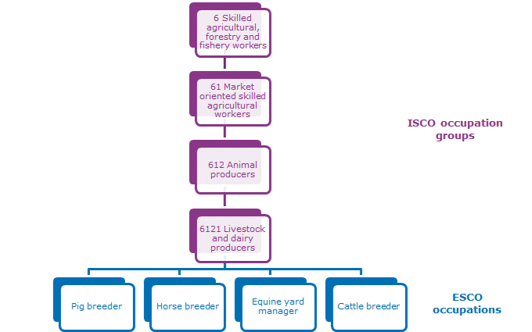
The occupations pillar

Slide 5
The skill/competences pillar
Skills transferability (mobility between occupations) as the main principle of the hierarchy
Groups divided based on at least one of the following:
a. Tools and equipment used.
b. The type of object on which the work is performed.
c. The function or outcome of the task or activity.
Concepts | Sub-hierarchies
Knowledge | International Standard Classification of Education, Fields of Education (ISCED-F).
Languages | A three-levels structure distinguishing between languages and classical languages.
Skills | An expert-built structure of a 3-level skill hierarchy, building on the Canadian Skills and Knowledge glossary and O*NET IWAs.
Transversal skills | Expert-created 2-level structure with six subcategories

Slide 6
level 1 group
level 2 group
level 3 group

Slide 7
Hierarchical architecture approaches
1) top-down approach
assigning concepts to pre-established categories
currently used in ESCO
2) bottom-up approach
groups built based on concept clustering
data-driven approach

Slide 8
History of the ESCO hierarchy
Series of pilots run in the past to explore usability of existing frameworks for the skills pillar:
European Dictionary to Skills and Competences (DISCO)
Kompetenzklassifikation (the German skills classification)
NACE (Statistical Classification of Economic Activities in the European Union)
ISCED-F (International Standard Classification of Education - Fields of Education and Training)
CPA (Statistical classification of products by activity)
None of them suitable for a mono-hierarchy, hence a group of ontology experts invited to create the current skills hierarchy

Slide 9
ESCO evolution
What’s next?
1) data-driven skills hierarchy
2) NACE-based occupational hierarchy
3) ?
Notes:
While the current hierarchy has been received well by the users and implementers, we still see the ESCO hierarchy as a continuous process of improvement and at this stage, before starting to work on a new major ESCO release, we are reflecting on some of the suggestions we have received from the users regarding easability to use the hierarchy. Also in line with our ambition to turn ESCO even more into data-powered knowledge graph mostly informed by data science and AI, we have started scoping out the idea of introducing an alternatvie data-driven hierarchy. You will hear more details about it in a bit from our main data scientist Jan.
At the same time, another scenario we are currently exploring is creating a second occupations hierarchy that will use the Statistical classification of economic activities in the European Community, in short NACE, as we have been seeing almost one quarter of implementers using NACE together with ESCO.

Slide 10
Bottom-up skill clustering
Bottom-up:
Each skill starts in its own cluster, and pairs of clusters are
merged as one moves up the hierarchy

Slide 11
Bottom-up skill clustering
Problem:
How to define a skill / skill cluster similarity metric?
Possible approaches:
Skill concept-level co-occurrence driven clustering
Semantic relatedness-driven skill clustering
Hybrid methodology for skill clustering

Slide 12
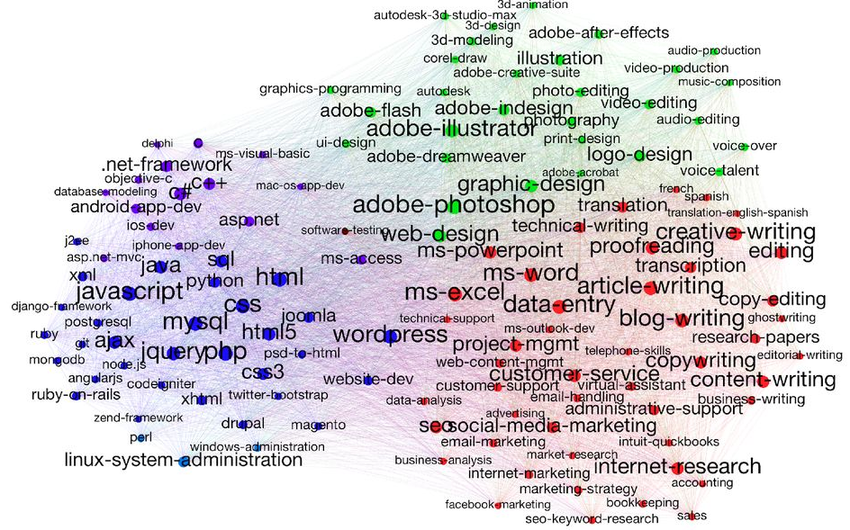
Skill concept-level co-occurrence driven clustering
Approach:
Create graph of skills from demand/supply side
E.g. from online job advertisements, recruitment platform
Connect skills if a worker has both or employer asks both
Connection strength = frequency of co-occurrence
Clustering by identifying strongly connected sub-communities
Pro:
Transparent metric
Challenge:
Requires sufficient amount of ESCO skill co-occurrence data from labour market
Words in the skills (and their meaning) are not used
Katharine A. Anderson, Skill networks and measures of complex human capital,
Proceedings of the National Academy of Sciences, 114(48), 12720-12724, 2017

Slide 13
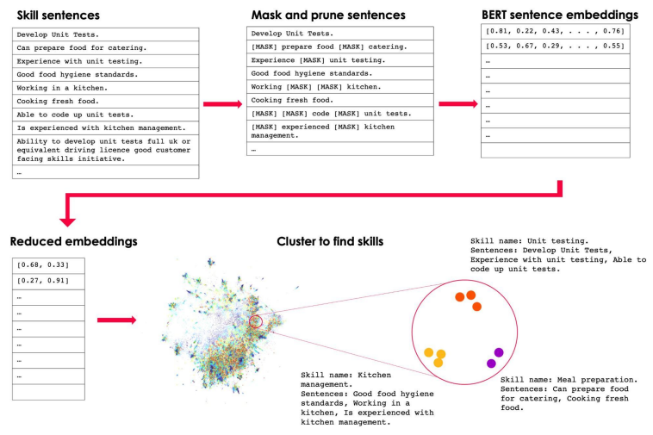
Semantic relatedness-driven skill clustering
Approach:
Skills = phrases from online job advertisements
Distributional hypothesis: words that share the same
context (i.e. neighbouring words) are more likely
to be related semantic relatedness
Apply approach via Sentence-BERT language model
(general web data) to compute vectors for skills
Group vectorised skills (k-means clustering) in stages
Pro:
Content (i.e. words) of skill phrases is used
Challenge:
Language model not tuned for labour market use-case
No direct usage of labour market skill co-occurrence statistics
Elizabeth Gallagher, India Kerle, Cath Sleeman, George Richardson, A New Approach to Building a Skills Taxonomy, Economic Statistics Centre of Excellence (ESCoE) Technical Reports ESCOE-TR-16, 2022.

Slide 14
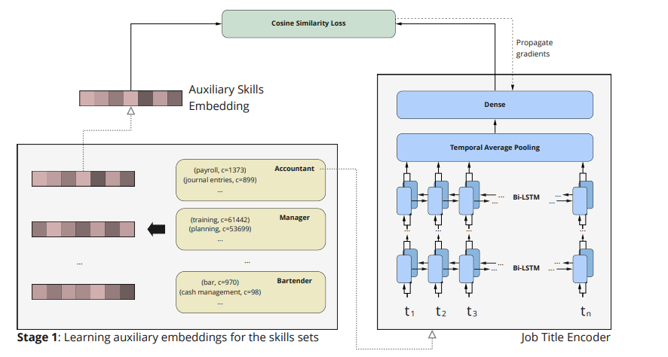
Hybrid methodology for skill clustering
Train language model on co-occurrence data:
Create skill co-occurrence dataset from
online job advertisements, CVs
Apply Doc2Vec semantic relatedness model on
co-occurrence data to compute vectors for skills
Train BERT language model to mimic Doc2Vec
vectors for any type of free text skill phrase
Pro:
Skill co-occurrence labour market data in
combination with language model
Challenge:
Requires sufficient amount of ESCO skill co-occurrence data from labour market
Doc2Vec + Skill co-occurrence
BERT language model
Rabih Zbib, Lucas Alvarez, Federico Retyk, Rus Poves, Juan Aizpuru, Hermenegildo Fabregat, Vaidotas Simkus and Emilia García-Casademont, Learning job titles similarity from noisy skill labels, Unpublished manuscript, 2022.

Slide 15
ESCO skill co-occurrence data from labour market
Supply:
Demand:
Related skills by Doc2Vec vectors on ESCO skill co-occurrence dataset:
calculate tax | employ translation techniques | aquaculture cultivation equipment | side effects of radiotherapy treatment
manage the general ledger | translate tags | develop aquaculture strategies | perform image guidance in radiation therapy
depreciation | perform sight translation | assess environmental impact in aquaculture operations | operate medical imaging equipment
accounting entries | follow an ethical code of conduct for translation activities | culture aquaculture hatchery stocks | administer radiation treatment
prepare trial accounting balances | interpret languages in conferences | supervise aquaculture facilities | advocate for healthcare users' needs
identify accounting errors | follow translation quality standards | inspect fish eggs | development trends in radiography

Slide 16
Discussion
Data-driven (skills) hierarchy
Where do you see the added value of data-driven (skills) ESCO hierarchy?
What can be the pitfalls of maintaining the data-driven ESCO hierarchy?
Would you recommend the use of data-driven clustering for the skills pillar, the occupations pillar, or both?

Slide 17
Discussion
Data-driven (skills) hierarchy
What factors should be kept in mind when introducing data-driven (skills) hierarchy in ESCO? (technical implications, consequences to implementers, data availability,..)
If the alternative (skills) hierarchy was to be pursued, which of the three types of clustering would you recommend? Which one would you not recommend?
What data sources could ESCO leverage for data-driven hierarchy?

Slide 18
Coffee break

Slide 19
Alternative hierarchies for ESCO
Mapping ESCO occupations to NACE sectors

Slide 20
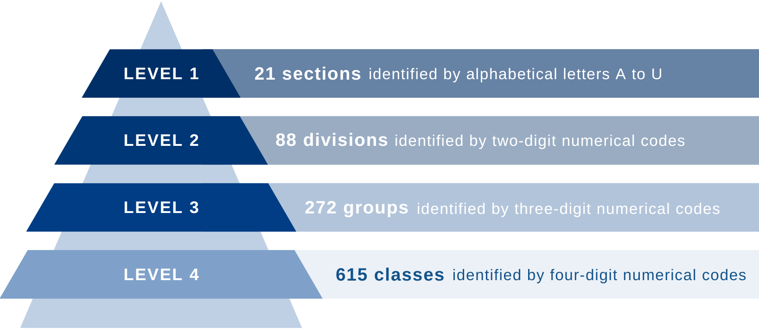
The NACE classification
The Statistical Classification of Economic Activities in the European Community, commonly referred to as NACE, is the industry standard classification system used in the European Union.
The current version is revision 2 and
was established by Regulation (EC)
No 1893/2006.

Slide 21
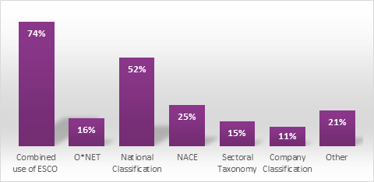
Why the NACE classification
European standard: the first four levels of the classification system are the same in all European countries.
Statistical classification: framework for collecting and presenting labour market statistical data (e.g. production, employment, national accounts).
International correspondences: part of an integrated system of statistical classifications, developed mainly by the U.N. Statistical Division.
NACE is derived from ISIC.
Use of ESCO in combination with other data sources
by ESCO implementers
Source: ESCO M&E report (2022)

Slide 22
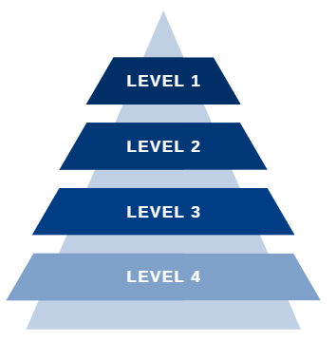
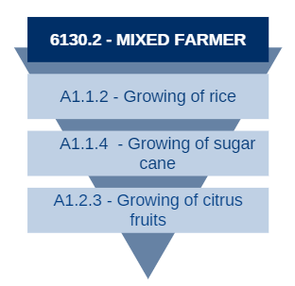
Clustering ESCO using NACE
Top-down
approach
ESCO occupations are assigned to predefined categories.
Poly-categorical structure
ESCO occupations can me mapped to multiple NACE sectors.
Hybrid
methodology
Use artificial intelligence combined the work of with experts.

Slide 23
Methodology
STEP 1
Collect OJVs published in the EURES portal
These are tagged with both ESCO occupations and NACE sectors
STEP 2
Run statistical analysis, clean and structure the data
Patterns are detected and compared among vacancies
STEP 3
Build a machine-learning classifier
The model is expected to learn to predict the NACE sector for ESCO occupations
STEP 4
Select the best performing model
Validate models using a past NACE-ESCO mapping done by the ESCO SECRETARIAT
STEP 5
Run additional validations and quality checks

Slide 24
Methodology
STEP 1
Collect OJVs published in the EURES portal
These are tagged with both ESCO occupations and NACE sectors
STEP 2
Run statistical analysis, clean and structure the data
Patterns are detected and compared among vacancies
STEP 3
Build a machine-learning classifier
The model is expected to learn to predict the NACE sector for ESCO occupations
STEP 4
Select the best performing model
Validate models using a past NACE-ESCO mapping done by the ESCO SECRETARIAT
STEP 5
Run additional validations and quality checks

Slide 25
The EURES dataset
VACANCIES
Number OJVs processed: 7,378,022
Number of connections ESCO occupation-NACE: 11,364,210
NACE
Number of NACE sectors level 4: 602/615
Number of NACE sectors level 1: 21/21
ESCO
Number of ESCO occupations: 2,871/3,008

Slide 26
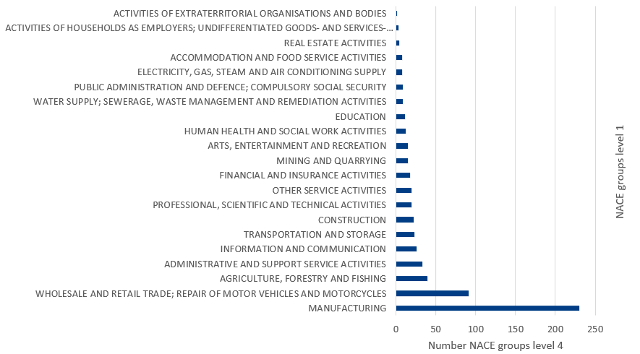
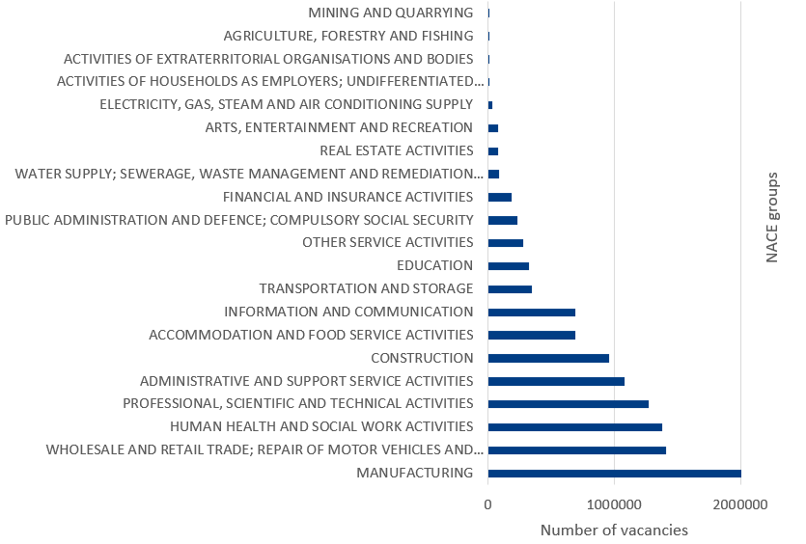
First insights – NACE structure and EURES OJVs
Size of NACE first-level groups
Source: NACE REV.2, ESCO elaboration
Size of NACE first-level groups
Source: EURES data, ESCO elaboration

Slide 27
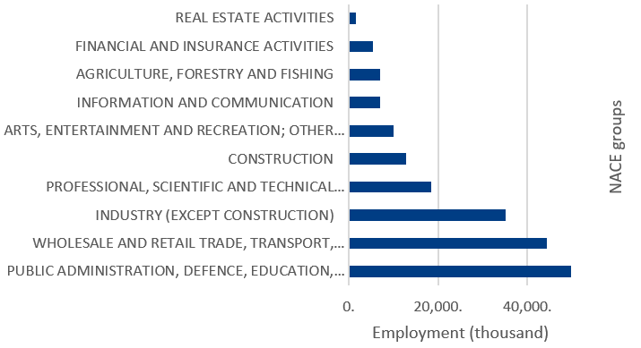
First insights – EU STATISTICS and EURES OJVs
Employment shares in the European Union (2021)
Source: EUROSTAT [LFSA_EPGN62], ESCO elaboration
Size of NACE first-level groups
Source: EURES data, ESCO elaboration

Slide 28
Discussion
NACE-based occupations hierarchy
Do you see introduction of NACE-based ESCO occupational hierarchy beneficial for ESCO?
What are the main advantages/disadvantages of NACE-based occupations hierarchy?
What factors should be kept in mind when thinking of introducing NACE-based ESCO occupations pillar?

Slide 29
Discussion
Concluding thoughts
What is the value added of introducing alternative hierarchies in ESCO? If any, what pillar should be prioritized in light of this work?
Are there any other hierarchical approaches you would recommend for ESCO?

Slide 30
Discussion
Final discussion
How to strike balance between technical feasibility and value added when selecting alternative classification of ESCO?
What type of ESCO implementers and users would benefit from the different classification alternatives proposed?

Slide 31
Next steps and farewell
Next MSWG focus group meeting: 10 November 2022
Topic: skills relevance in occupations

Slide 32
#ESCO_EU

empl-esco-secretariat@ec.europa.eu
linda.kunertova@esco-support.eu
laura.visan@esco-support.eu

