Slide 1

Skills clustering in Rome 4.0
State of play
14 septembre 2022

Slide 2
Context in a few words
Starting point : 2019

Slide 3
Reasons for pivoting from « occupations » to « skills »
context
A skill centric labour market is more fluid than an occupation centric one
A relevant skills classification will offer a common language to all actors on the labour market : job seekers, recruiters, training organizations, schools, ...
facilitate professional retraining
promote lifelong guidance
facilitate data sharing
…

Slide 4
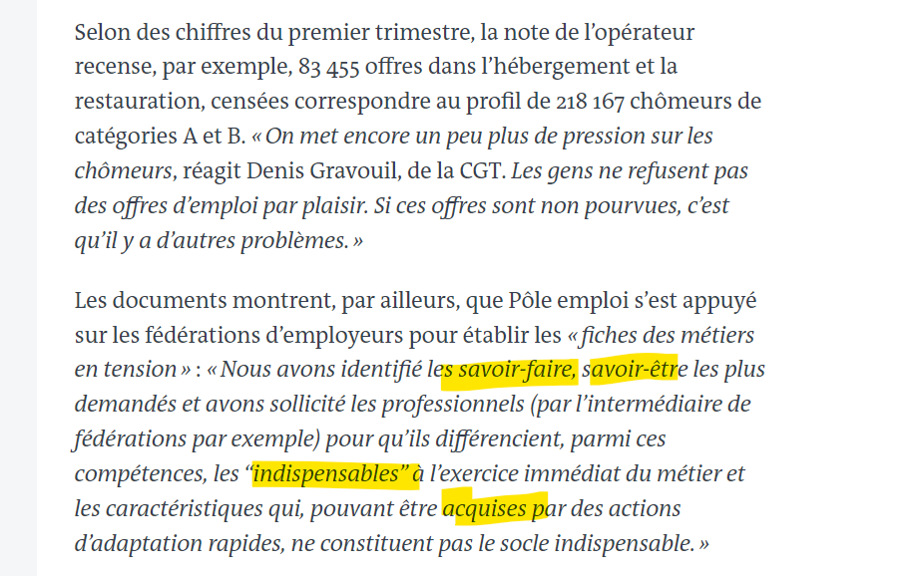
To alleviate the tensions on the labour market in the hotel and catering, health and social services and transport sectors, proposes to think in terms of skills and not occupations
Context
An example of a skil centric approach
https://www.lemonde.fr/politique/article/2022/09/08/pole-emploi-veut-creer-un-vivier-de-chomeurs-pour-combler-les-penuries-de-main-d-uvre_6140678_823448.html
Pôle emploi relied on employers' federations to draw up "files on jobs in short supply":
"We identified the know-how and interpersonal skills that are most in demand and asked professionals (through federations, for example) to differentiate, among these skills, those that are "essential" for the immediate exercise of the job and those characteristics that can be acquired through rapid adaptation actions and do not constitute the essential base.
Translation DeepL
extract from an article published in Le Monde on 8 September 2022

Slide 5
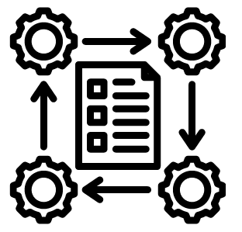
Procedure
iterations between humans, computers and organizations

Slide 6
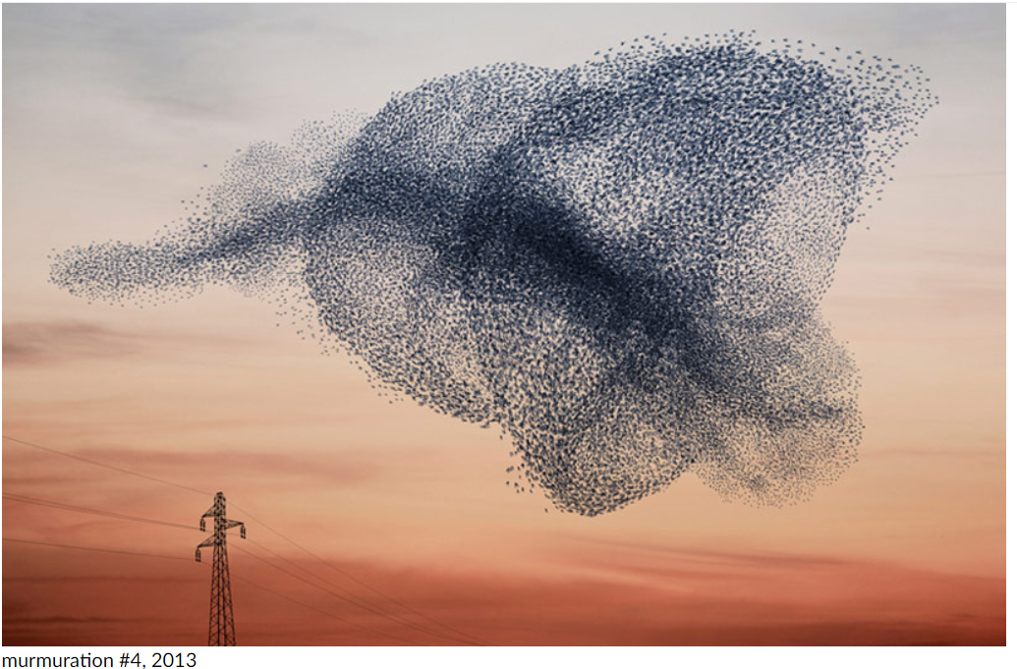
Procedure : AI + humans + organisations
Starting in 2019, Pôle emploi began a collaboration with a start-up, specialised in Text Mining
The 12.000 skills of the ROME v3 were scanned and analysed.
Skills Clusters has emerged from this first step. They were presented to a team of specialists at Pôle emploi, who challenged, adaptated, named them. In the end, 6 clusters were kept (see next slide)
Once the clusters choosen (their names + the skills composing them), they are chared with the industries in France, and once again challenged, adaptated, renamed, refined, extended etc
The process is still ongoing

Slide 7
6 clusters
yesterday
6 clusters
5 clusters
Relation
Innovation
Technique
Organisation
Economique
Transverse
Collaboration | Connaissance Créativité | Maîtrise Expertise technique | Règles Efficacité | Performance Entrepreneuriat
Management, Animation * | Formation Education | Technologies Machines, outils | Planification Pilotage | Rentabilité Achats
Gestion des RH et conduite du changement | Données / Innovation | Production Qualité | Organisation Direction | Stratégie Marketing
Relations externes Service | Contenus de Communication Médias | Logistique Transport | Règlementation Contrats | Commercial, relation client Distribution
Lien social Santé, Solidarité | Art Culture Patrimoine | Environnement Construction Aménagement | Politiques publiques | Développement économique Attractivité
L’individu
L’équipe
5 scales
L’entreprise
Les clients /
Les marchés
Le territoire /
l’intérêt général

Slide 8
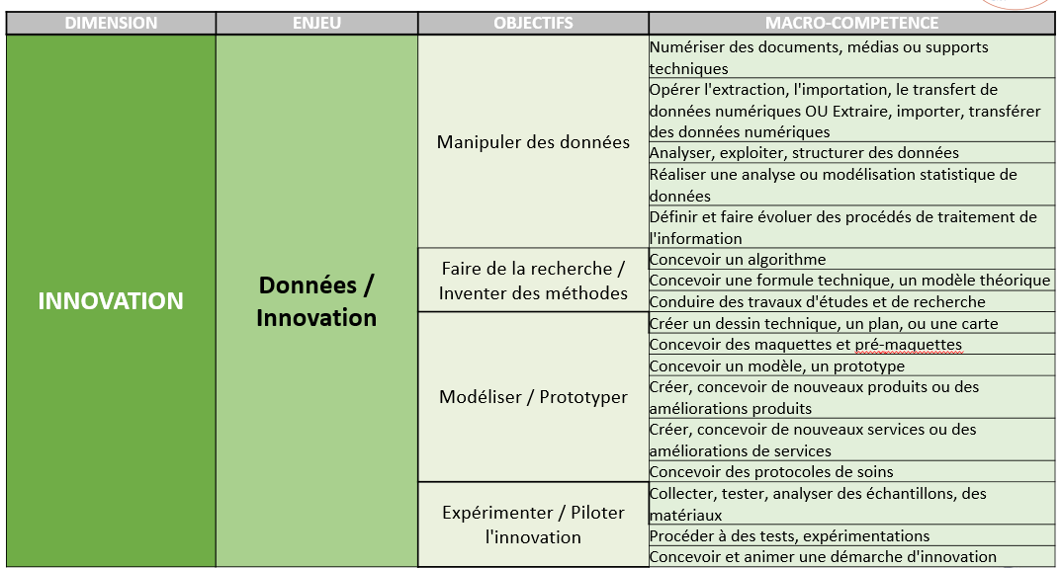
The whole tree of skills : from the big Cluster to the Macro-Skill
Macro-skills in Rome 4.0:
- There are about 500 macro-skills
- they all start with an action verb
- Examples: manipulate data, negotiate a contract.
- This is the level that is shared with industries in France.
The objective is that the macro-skills level be shared by everyone in France: training organizations, recruiters, employers, ministries, etc.
Discussions with industries are currently underway and there could ultimately be more than 500 macro skills.

Slide 9
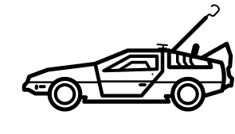
Back to the future
Not in 1985, in 1993

Slide 10
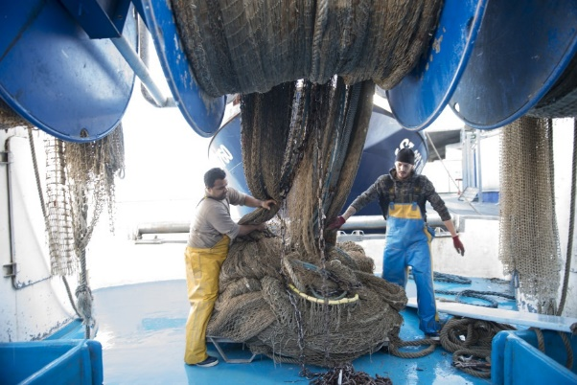
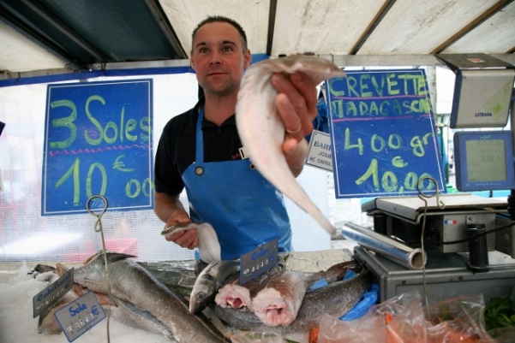
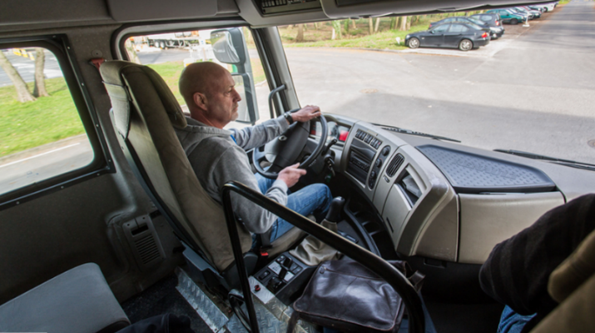
How can a job be close to another when they do not look similar ?
ROmE v2 : moblility areas
In 1993, this question was raised.
It is still relevant today. And the answers then given can still inspire us today. See the axes next slide
A fishing sailor has more in common with a truck driver than with a fish merchant: time management, large spaces, autonomy, team work, ...

Slide 11



How can a job be close to another when they do not look similar ?
ROmE v2 : moblility areas
The intellectual approaches
Application : following a process and knowing what the output is going to be
Transposition : knowing process, adjusting them in order to produce a one-time output
Creating : a very rare type of approach, for musicians or novelists for instance
The relationship to time & space
Time : second, hour, day, week, … years
Type of events : expected or non expected, emergency, variety (little or many)
Space : it’s about working environment (heat, noise, indoor, …) or even the scale from the desk to the whole world
Interaction with people
frequency of interaction
nature of interaction : beside, in front of, with
The next part of this document is a scan of the 17 pages written in 1993 where all the method is discribed. Let’s switch to French.

Slide 12
Thank you

Slide 13
Aires de mobilité dans la version 2 du ROME
1993

Slide 14
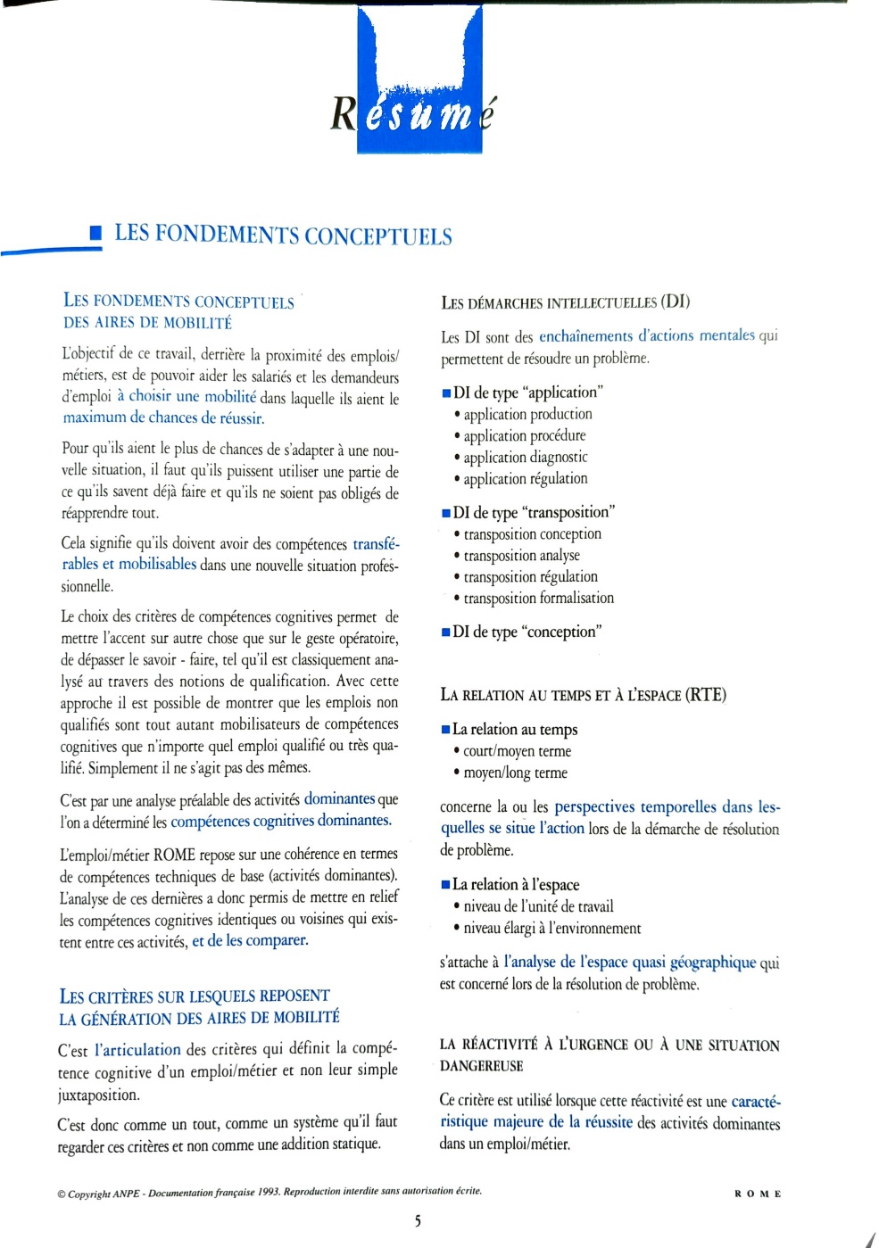

Slide 15
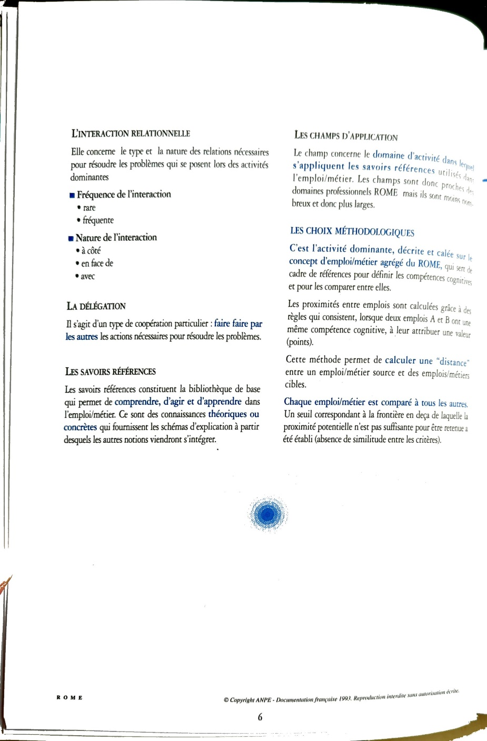

Slide 16
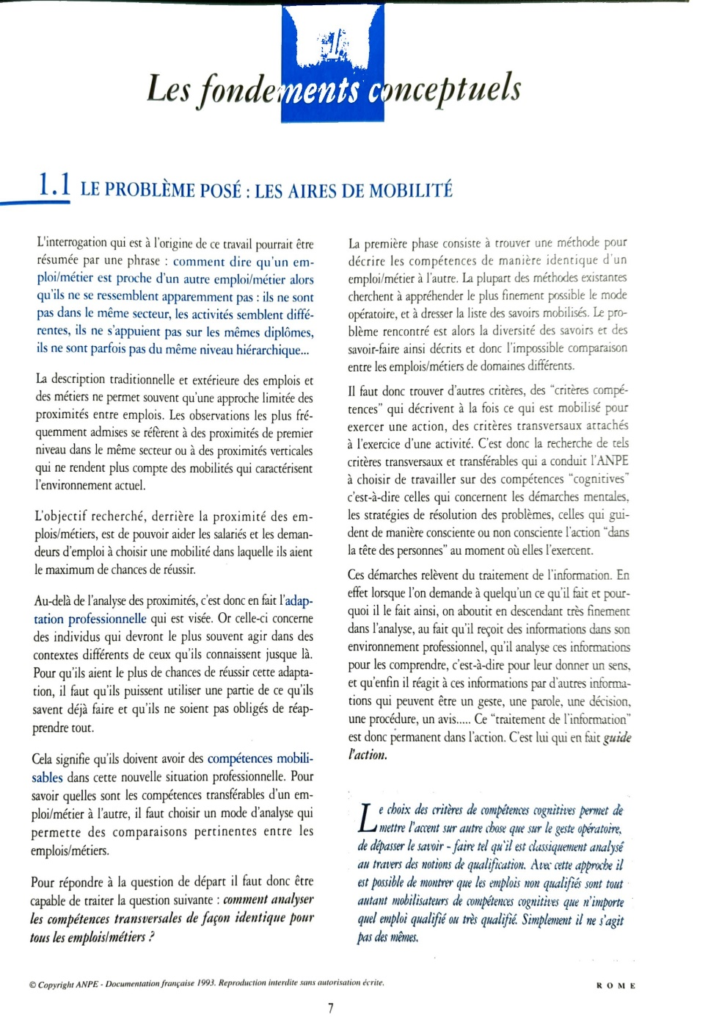

Slide 17
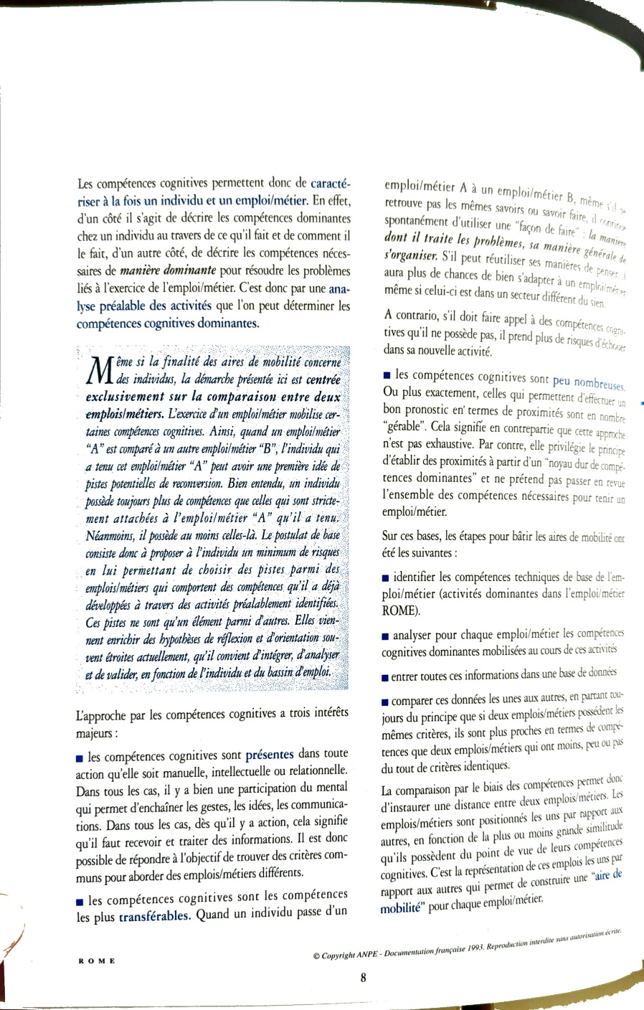

Slide 18
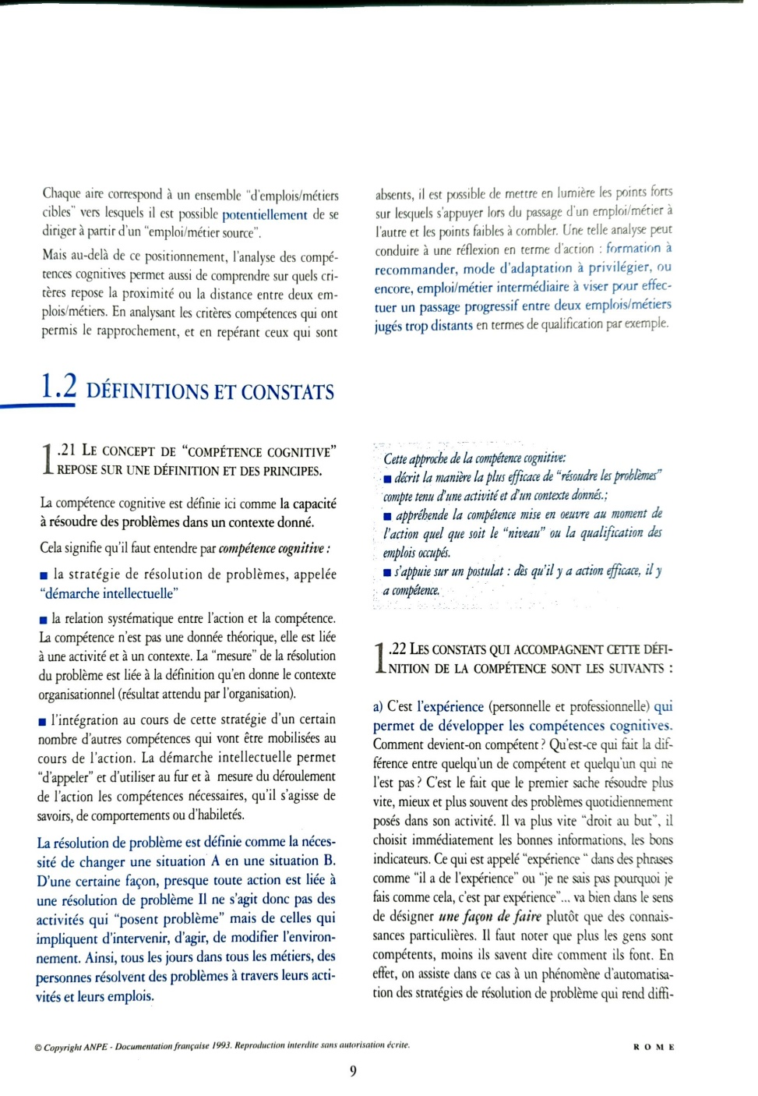

Slide 19
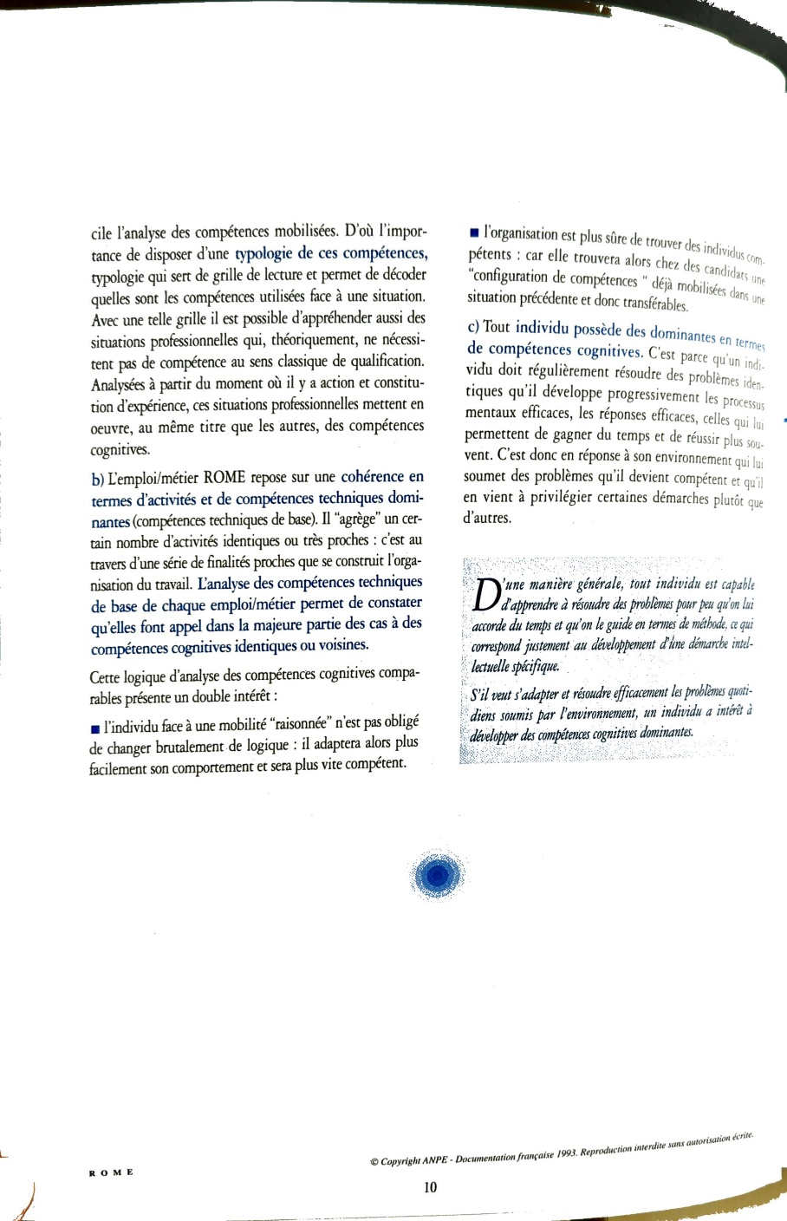

Slide 20
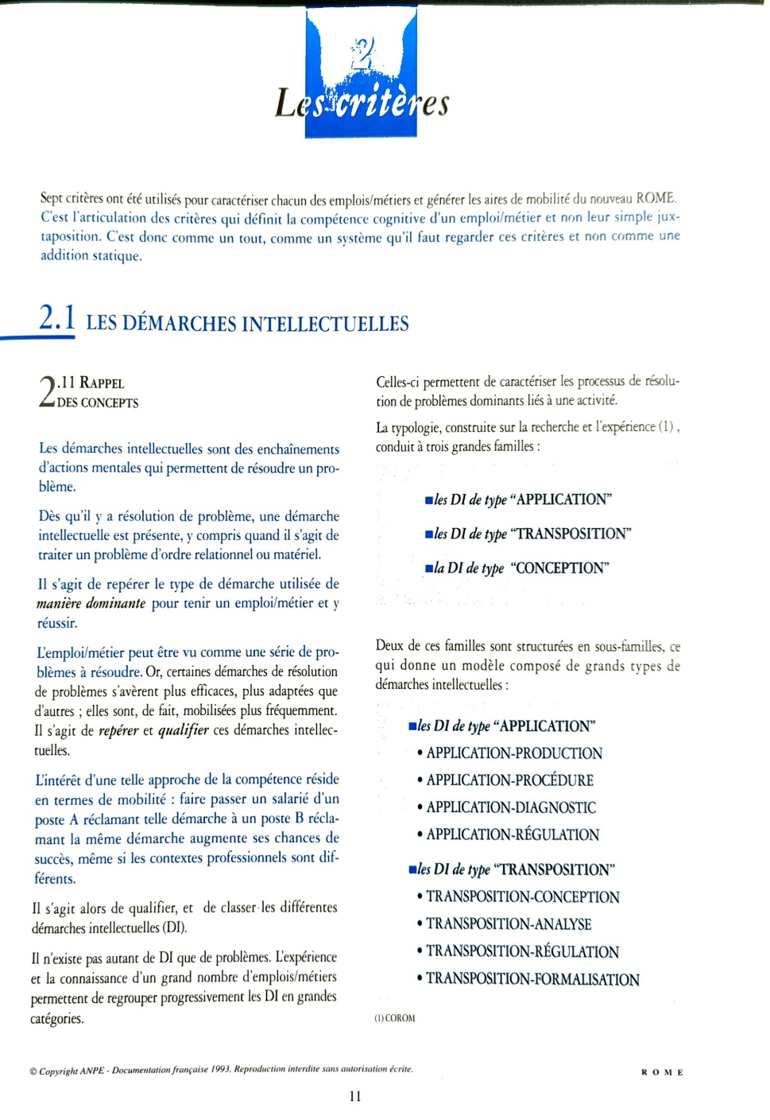

Slide 21
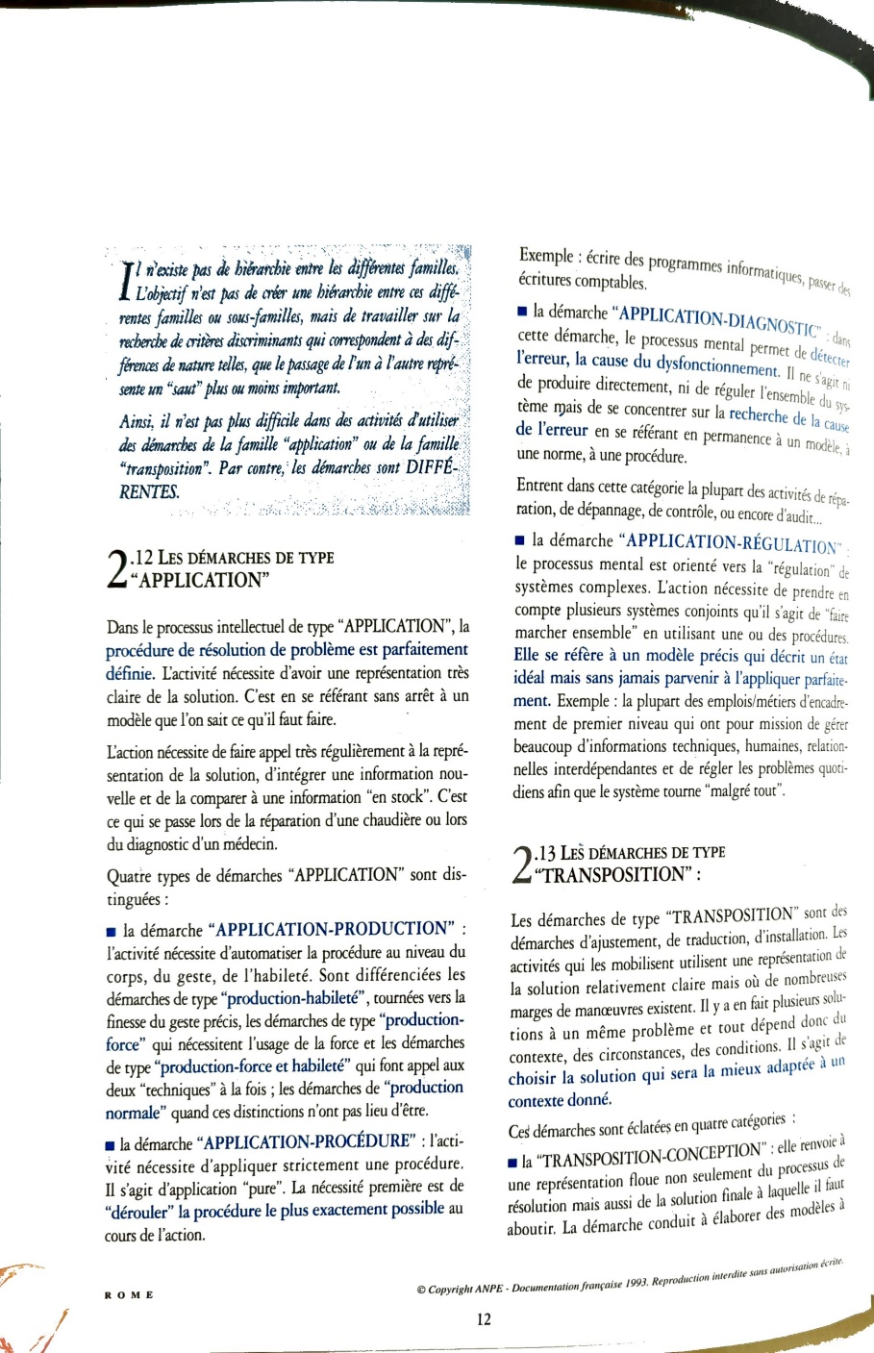

Slide 22
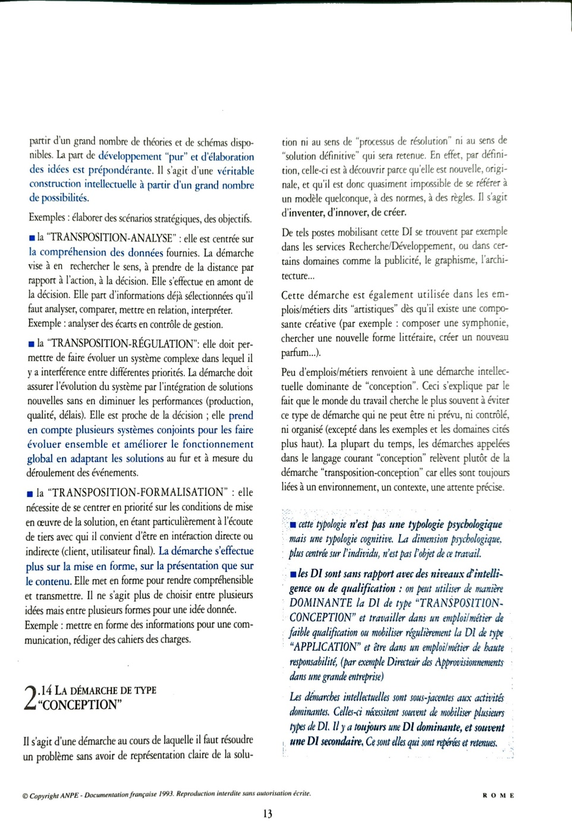

Slide 23
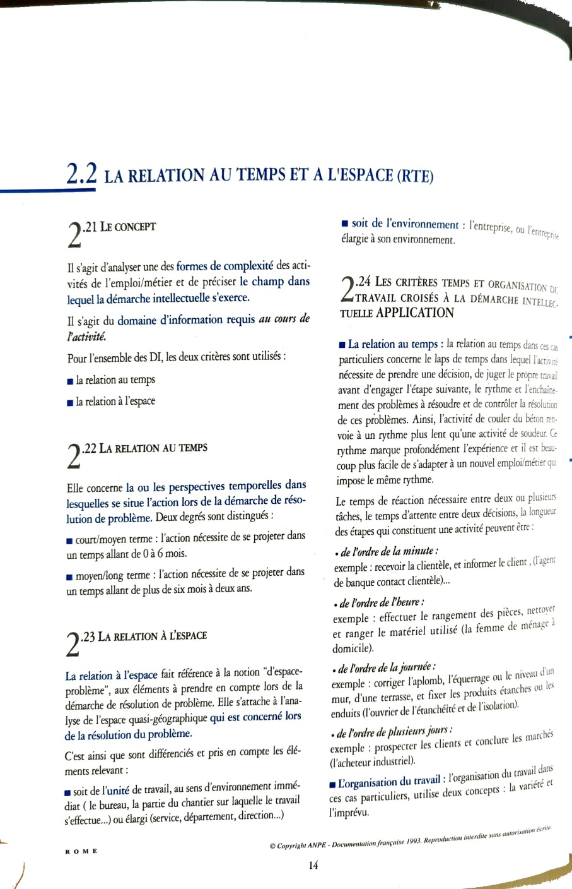

Slide 24
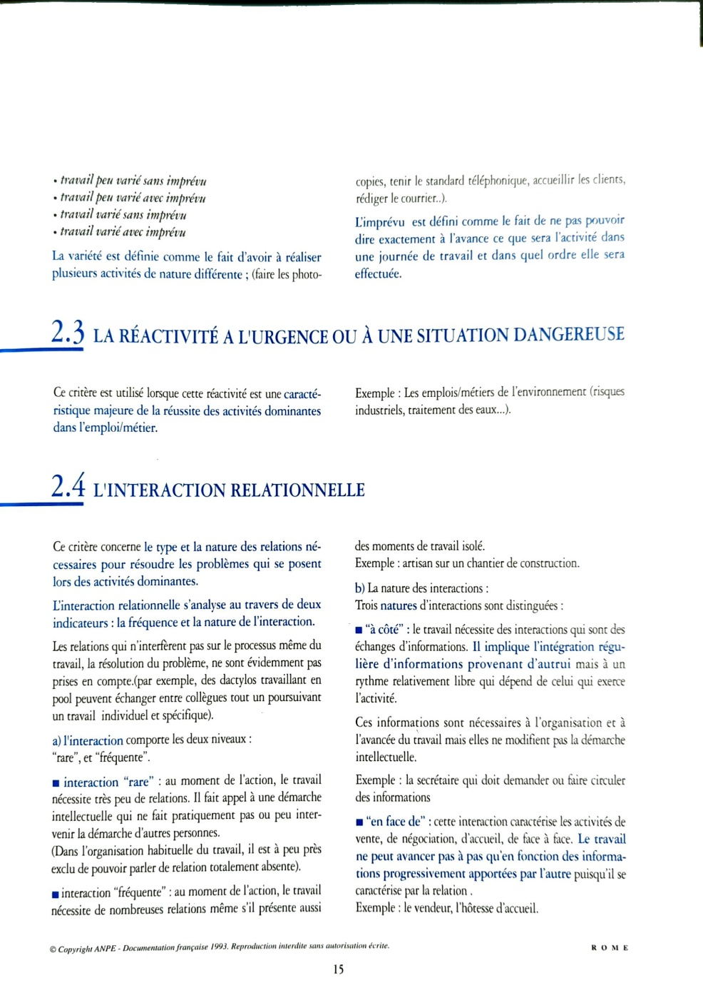

Slide 25
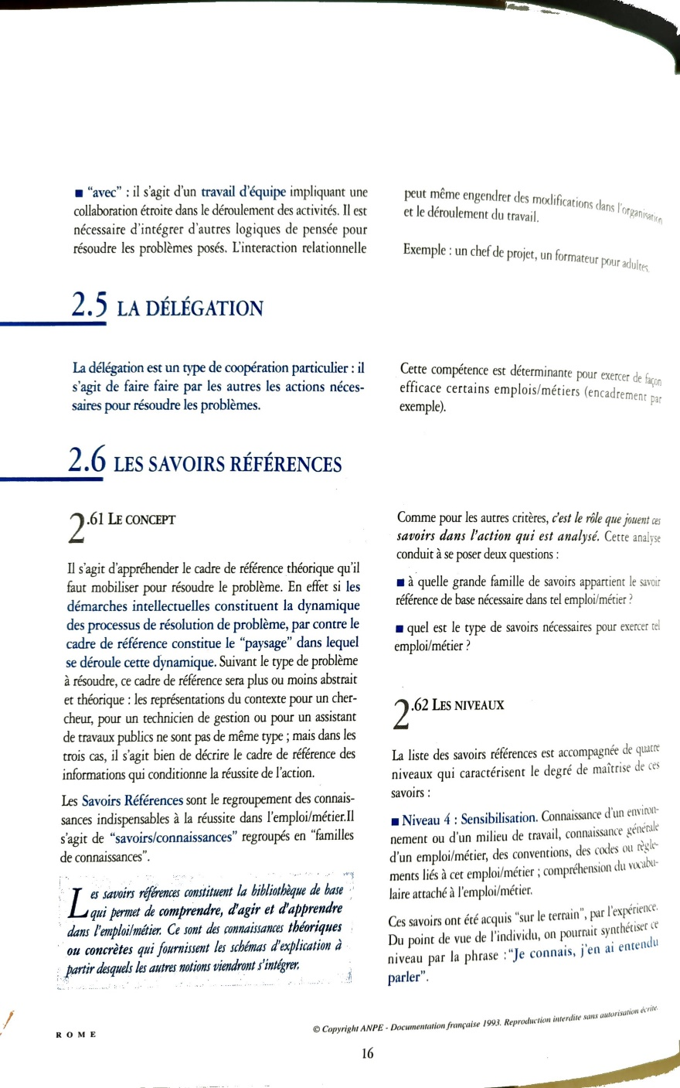

Slide 26
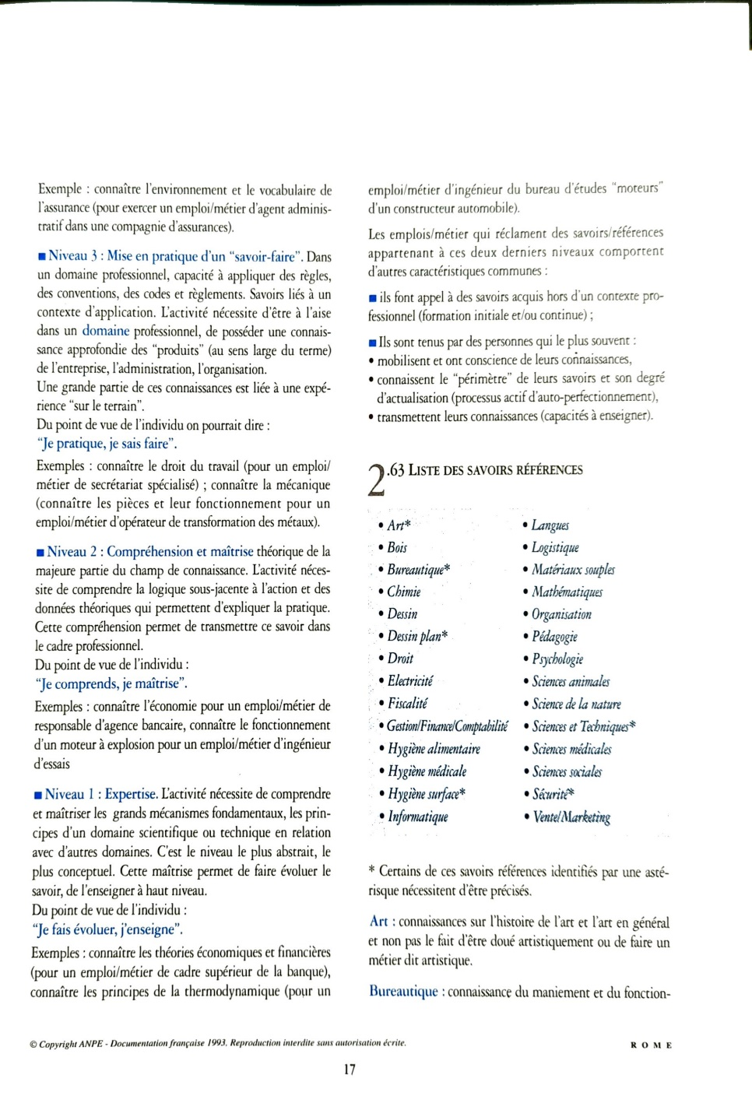

Slide 27
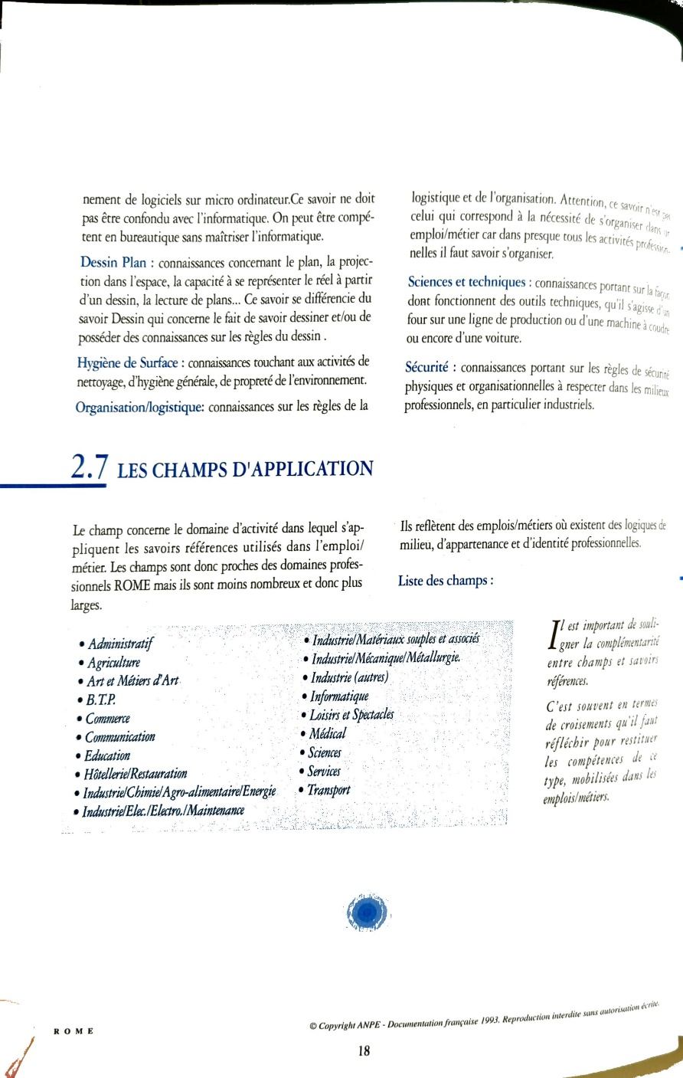

Slide 28
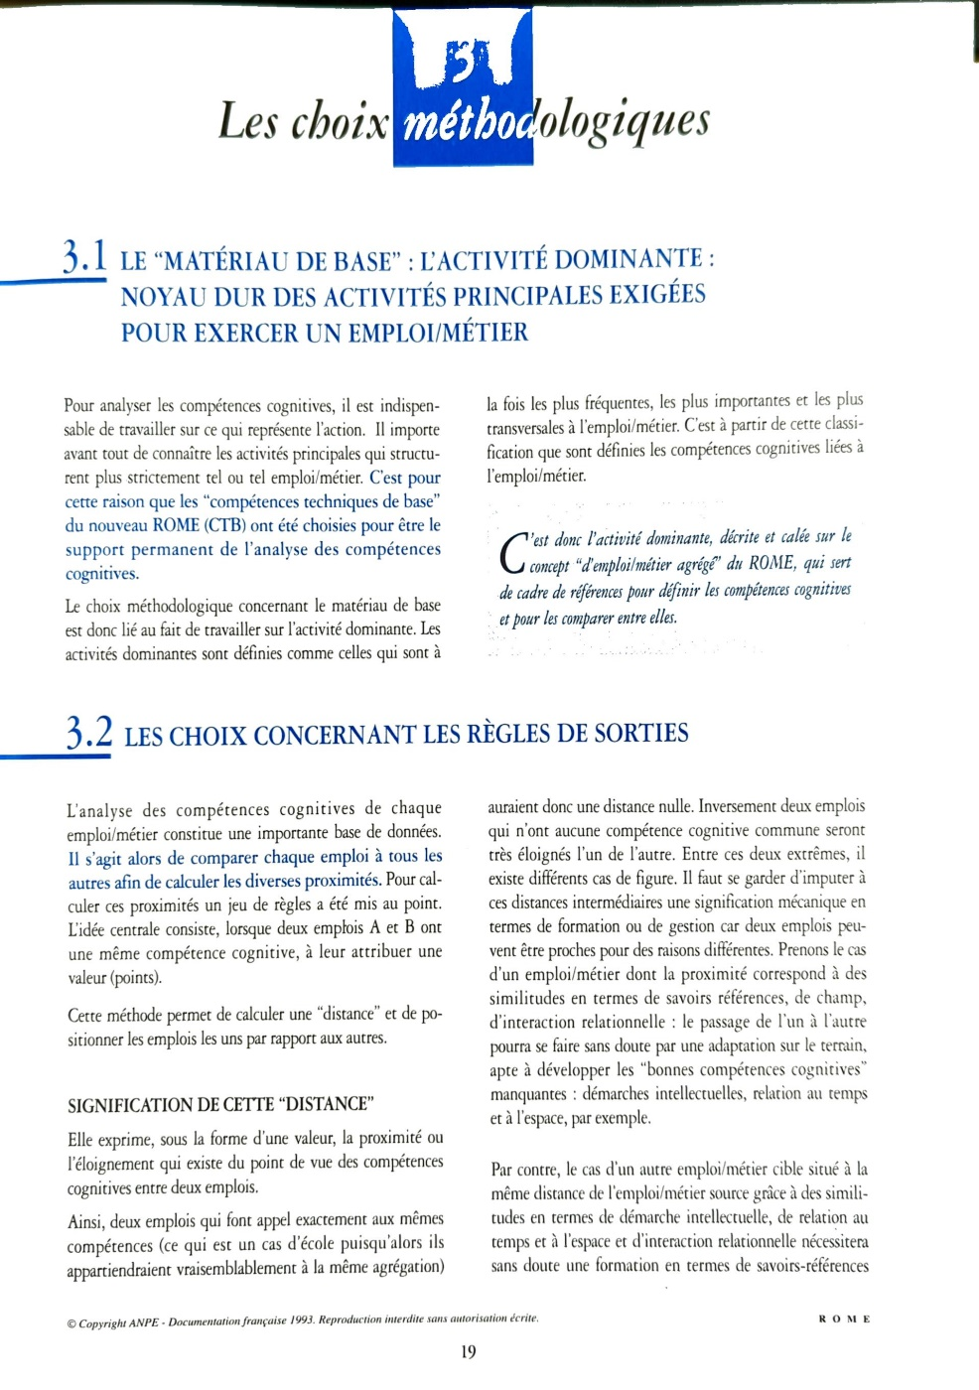

Slide 29
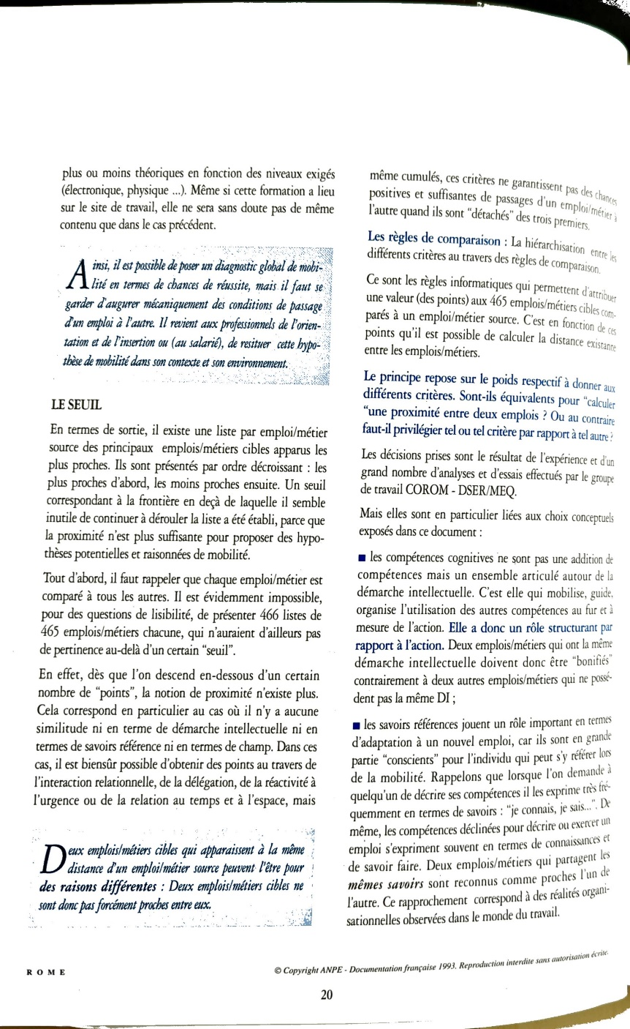

Slide 30
