Slide 1
ESCO Matching Peru
ESCO MSWG 10-NOV

Slide 2
Agenda
Introduction – Context of matching
Introduction MTPE (PES PERU)
ESCO as matching model at MTPE
Any questions

Slide 3
Introduction
CONTEXT of Matching
Traditional vacancy / candidate matching
  Advertisement in the newspaper
  Review of received CV’s (certain elements highlighted if required) by a HR-person, administration person or director/company founder
  Short list selected of 5 most suitable candidates based on the open position, suitability based on previous werk experience and skills, education, language, training and licenses etc.
Automated matching
  Advertisement in an online portal
  Automatic matching based on candidate profile; suitability based on previous werk experience and skills, education, language, training and licenses etc.
  Short list is presented

Slide 4
Introduction
CONTEXT of Matching
Automated matching – profile of vacancy and candidate
  A generic and understood language is required for both parties (jobseeker and employer) which applies to all match elements such as previous werk experience and skills, education, language, training and licenses etc.
  Most PES’s are mostly focused on the blue collar jobs as well as white collar jobs in hospitality, health, logistics etc.
  This implies that the ‘language’ offered must be easy to comprehend
    Example on education: I went to “Car mechanic School” vs “Vocational training for mechanics”.
    Example on work-experience: I worked as a ‘admin assistant’ vs ‘office clerk’

Slide 5
MTPE (PES IN PERU)
INTRODUCTION
MTPE is the PES in PERU that has decided to put a high focus on self services and implemented an employment web portal for jobseekers, employer and counsellors
Candidates can fill in their profile and get automated matched vacancies. The employer can add a vacancy and get the automated matched candidates. The counsellor can support both in tuning the profile if needed.
The knowledge model behind this portal contains many elements like location, local education, training and licenses, languages etc. And the jobtitles (occupations) and Skills are ESCO Spanish based.

Slide 6
MTPE (PES IN PERU)
ESCO as occupation / skills knowledge model
The ‘pure ESCO’ can not be used but requires localization and become match(/gap/referral) ready in an automated matching environment.
Localization also means tuning the European Spanish to LatAm Spanish, more specifically to Peru Spanish.
In previous MAI meetings it was highlighted often that ESCO ‘pure’ has duplicates, triplets etc. Currently these are being processed and will be part of future ESCO releases.
How to generate an initial knowledge model using ESCO and have it ready for profiling (CV and Vacancy) and automated matching?

Slide 7
MTPE (PES IN PERU)
ESCO as occupation / skills knowledge model
Both in matching and in training transversal skills are important (not transversal like languages or attitudes and values) but transversal in the sense they occur in multiple occupations.
  Occurring in multiple occupations it also means this skill has relevance and valid for skill-based matching. It has no value to collect a skills from work experience that is purely attached to that single occupation. How to calculate the occurrence?
    Limit it to each ISCO Level 1 (Major) group, not mix the occurrence between ISCO 3,4 and 5 for example.
    Calculate the occurrence of each skill within that ISCO group and reorder it to occurrence / popularity

Slide 8
MTPE (PES IN PERU)
ESCO as occupation / skills knowledge model
In ESCO each skill also has a Skill reusability level property
  The Skill reusability level provides input of whether the skills is
    sector-specific
    cross-sector
    occupation-specific
    Transversal (this is the transversal definition of ESCO, e.g. Speak English, not how often a skills occurs in an occupation.
Use the input of the first three to rebalance the previous exercise, extra weight for cross-sector, little less for sector-specific and little less for occupation-specific.
The last one, occupation-specific is already know from the popularity check of skills in the previous process.

Slide 9
MTPE (PES IN PERU)
ESCO as occupation / skills knowledge model
In ESCO each skill also is connected to Skill Hierarchy
  Using this information, you can also check if certain popularity skills are with the same hierarchy level. Use also the internal esco narrow and broader. This is an extra input, for example:
    If both Serve Wine and Decant Wines are equally part with the occupation, then we remove Decant wines, since this is a Narrow concept of Serve Wine, and in Match we don’t need both.
Now we have a clean starting point of popularity of skills per occupation
In Profiling; experience with PES implementation and jobseeker/employer feedback shows we want max 20 skills per work experience (including implicit). Most people get overwhelmed with too many skills that might also look the same, which one should I select ?
The process to come to maximum 20 skills per occupation,
  This limited the skill repository from ~13500 to ~5000 and enable better matching and referral (filling in gaps with training)

Slide 10
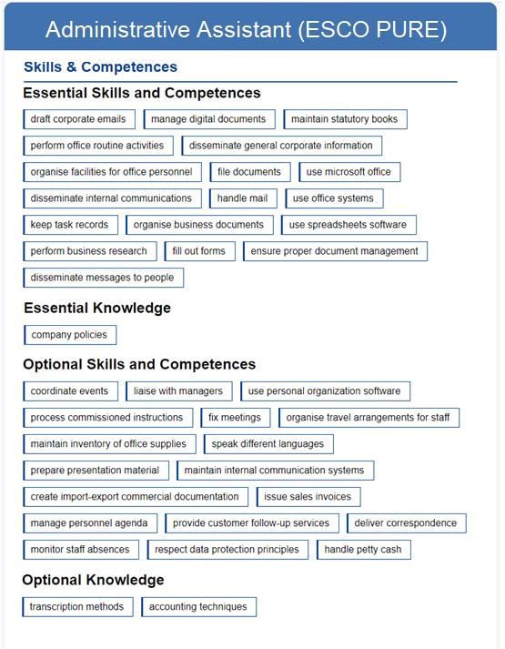
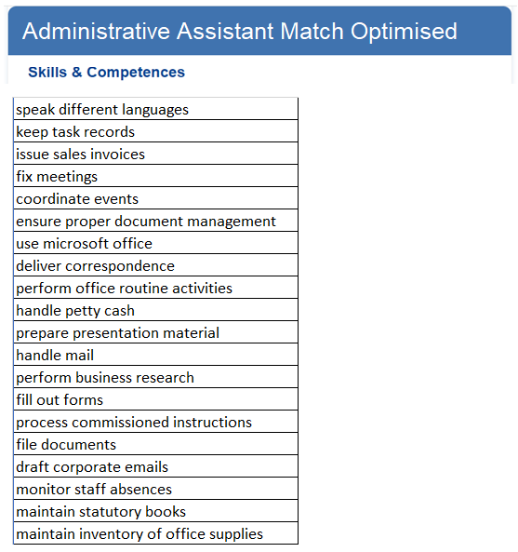
EXAMPLE after optimizing the Match model

Slide 11
MTPE (PES IN PERU)
ESCO as occupation / skills knowledge model
Continuous maintenance process after starting point
  Validate data every 6 months, what are the implicit skills (often selected), these can be auto selected and applied in a profile. For example, the bar tender vacancy will always select ‘Serve Wines’; for the next employer with this vacancy the skill will be pre-selected as ‘implicit’.
  This process takes all candidates and vacancies submitted over the last 6 months.
  Feedback from counsellors;
    certain skills or jobtitles obsolete or unclear, feedback from employers and candidates
    Counsellors are allowed to update the knowledge model and publish it into the Portals
  Labour market updates and ESCO Updates;
    certain emerging skills/occupations to be added, sun setting occupation to be highlighted as less optimal demanded vacancy titles.

Slide 12

QUESTIONS?

Slide 13
Thank You!

Slide 14
Introduction
CONTEXT of Matching
Digital matching – ESCO skills
  In case a PES is using ESCO as the occupation and skill taxonomy there are ~13500 skills available.
  During profiling of workexperience the system should capture the implicit skills as well as showing a limit set of skills.
  Example:
    Candidate has 5 previous workexperiences and (s)he selects the highlights per experience (not the obvious/implicit ones) and out of 200 skills in total (5 workexperiences) there are 25 selected.
    The employer fills in a vacancy and for a position with 35 skills and selects 5.
    Out of these 5 the candidate also happened to select 1 of them.
    Skill based; is this a valid match ? A suitable candidate to be shortlisted to the employer ?

Slide 15
Introduction
CONTEXT of Matching
Digital matching – skills
  A continuous interesting and well researched topic is skills-based matching.
    You have no idea of the extend of the labour market (occupations etc.) but are mid 40’s, mid career and have 20 years of work experience in different roles.
    If the online profile can capture all the skills acquired we can do skill-based matching to vacancies and get results of positions that the candidate might not have known.
    As also indicated in many researches there are also a lot of implicit skills, as an example we all understand that a bucher with 5 years understand different types of meat, cutting and preparing procedures etc. However if the advertisement is for a halal butcher, only the halal capability will be highlighted.

